Slide 1
Introductory Cosmology
CosCOM 2023
Piyabut Burikham

Slide 2
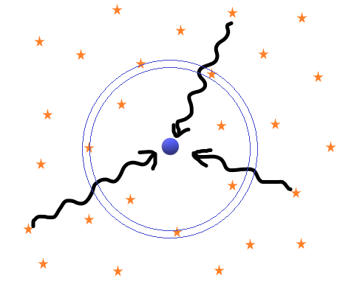
Problems with Newtonian Cosmology
Gravity attracts, mass should clump, universe should be dynamical → infinite universe as solution, i.e. no center to collapse to!
Olber paradox → infinite universe forever exists has infinite radiation flux at any point!!

Slide 3
Space is dark → Finite Universe with finite age!
Infinite Universe existing ever forever must be utterly dark(run out of fuel), full of black holes.
Finite Universe existing ever forever must have collapsed completely into single gigantic black hole.
Alternatives emerge in General Relativity(GR);
Closed, Flat, Open dynamical Universe

Slide 4
Hubble discoveries
Using Cepheids’ Period-Luminosity relation discovered by Henrietta Leavitt, establish that spiral “nebulae” are spiral galaxies! Hence Universe size is hundreds thousand times larger than believed at that time.
(1929) Found linear relation between redshift&distance of far away galaxies,
This is called Hubble law, will derive later from FLRW metric.

Slide 5
GR → spacetime lump = Universe
Gravity = Spacetime curvature = energy&momentum density.
Matter tells spacetime how to curve,
Spacetime tells matter how to move.
Where Ricci tensor and the Riemann curvature
tensor is given by
The energy-momentum tensor contains info of matter
And energy distribution.

Slide 6
Two more curvatures
Ricci tensor:
Ricci scalar:
Ex: sphere ,
(Use Mathematica to) compute
Hyperbolic ,

Slide 7
Cosmological principle(Newton&Einstein)
Homogeneous universe: uniform and is the same everywhere
Isotropic universe: is the same in every direction
Homogeneity implies no special point in universe. Combined with Isotropy implies that there can’t be special direction(anisotropy) and special observer in the universe.

Slide 8
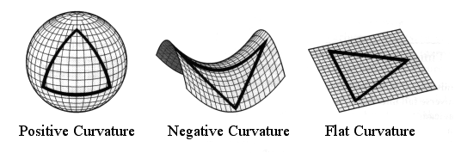
FLRW metric ansatz
Friedmann was the first (1922), most generic metric obeying cosmological principle
From homogeneity, we demand that
Picture from https://pages.uoregon.edu/jschombe/cosmo/lectures/lec15.html

Slide 9
3D shape of Universe
(Use Mathematica to) compute
We can solve to obtain
By redefining
Hubble law is natural.

Slide 10
Solve Einstein eqn. from this metric
Assume perfect fluid:
Will use Mathematica to compute later.
Note the relation in FLRW metric:

Slide 11
Einstein field eqn. of FLRW metric
Friedmann equation
Acceleration equation
Another redundant eqn. from
Dark Energy
Observe that accelerated expansion requires

Slide 12
Linear equation of state
To solve for 3 unknown , we still need what-so-called Equation of State (EoS), i.e., additional info about
For compact object, it could be polytrope , or even
But for cosmology, it suffices(?) to assume linear EoS ;
Sub into conservation eqn. to obtain
Sub into Friedmann eqn. to obtain

Slide 13
3 main eras of Universe
radiation-dominated:
extremely hot so that most particles can treated
relativistically.
matter-dominated:
cold enough to treat as non-relativistic particle →
simplified to “dust”.
Dark energy dominated:
roughly 8 billion years ago until present, accelerated
expansion of Universe.
Density parameter: From Observations,

Slide 14
Another era, curvature era
Even though (non-normalized) k is close to 0, there is error bar, so there could be a slight spatial curvature in the Universe!
Curvature effects emerge at later time:
Non DE effects will fade away as Universe evolves. So curvature could dominate (or important) between matter-era and DE-era → One possible proposal for Hubble tension solution.

Slide 15
Friedmann eqn. in density parameters
Generalized form of Friedmann:
Quite interesting that curvature lies at boundary
between DE and non DE, not accelerate nor decelerate
the expansion of the Universe.

Slide 16
Universe as a horn!

Slide 17
Stretched horn!

Slide 18
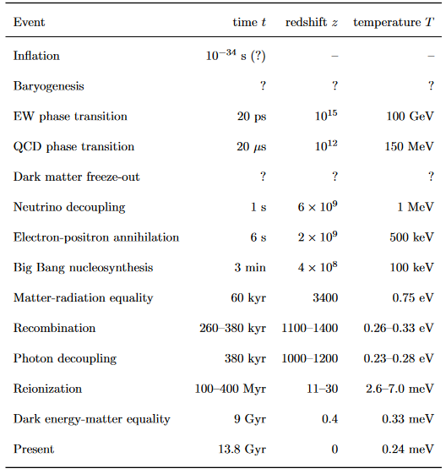
Credit:https://cmb.wintherscoming.no/pdfs/baumann.pdf

Slide 19
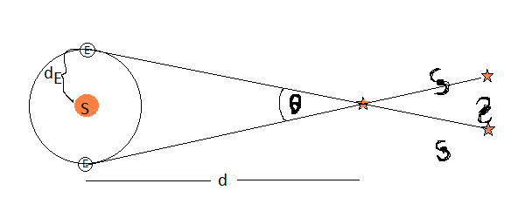
Distances in cosmology
Parallax: astrophysically short distances determined
by parallax.
Hipparcos satellite (ESA):

Slide 20
Distances in cosmology
For z > 0.1, cosmological expansion non-negligible, how to
determine distances at large z ??
At time that light reaches Earth, proper area seen by source is

Slide 21
Distances in cosmology
2. Arrival rate of photons is lower than emitted rate by
3.
Therefore,
For light travels radially since

Slide 22
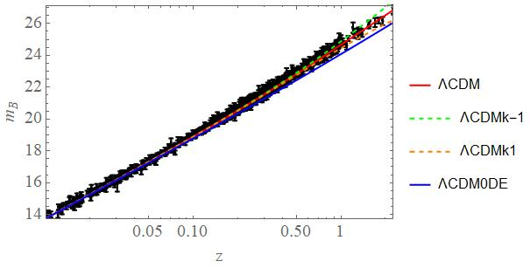
Luminosity distance
Pantheon, 1048 SNIa data, doi:10.3847/1538-4357/ac8b7a

Slide 23
Universe is accelerating with DE for z<2.3
Late time DE dominating era: recall
so Universe was started to be DE dominated
when its roughly half the size of present!
DE → k → matter → radiation → Inflation(?)
Lets study Thermal History since Radiation era.

Slide 24
Thermal History
Natural units: space = time, E = m = 1/space
Include temperature:
Ex: find Planck mass in natural GeV unit

Slide 25
Thermodynamics in expanding Universe
Early U is in radiation era with ultra-relativistic particles → massive relativistic gas → massive non-relativistic gas
as U expands. (radiation era → matter era)
Assume thermal equilibrium & interactions are taken into account by Boltzmann eqn.
From CMB, its safe to assume thermal equilibrium at single T throughout the U.
U Expansion →

Slide 26
Number density, density, pressure
1st law thermodynamics →

Slide 27
Ex photon gas
Generically for ultra-relativistic
particles in thermal equilibrium;

Slide 28
For ultra-relativistic particles at each own equilibrium with
Generically relativistic particles ignoring effects;
Ex: compute

Slide 29
Non-relativistic particles(gas&dust)
Ex: Show this.
For neutrinos, there are left-handed 3 flavours &
right-handed sterile ??? flavours;
Has to multiply by 2 to account for particle&antiparticle,
neutrinos will decouple the latest due to small masses.

Slide 30
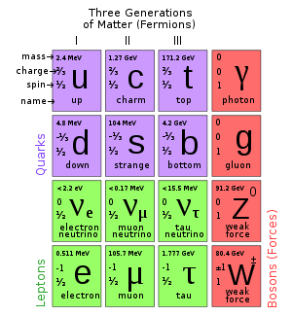
Standard Model particles
+Higgs, m=125 GeV
Possible to have
sterile neutrinos which
does not interact with
anything except via
gravity! → warm DM
Warm DM is harder to
reconcile with
structure formation.

Slide 31
Evolution of relativistic d.o.f.

Slide 32
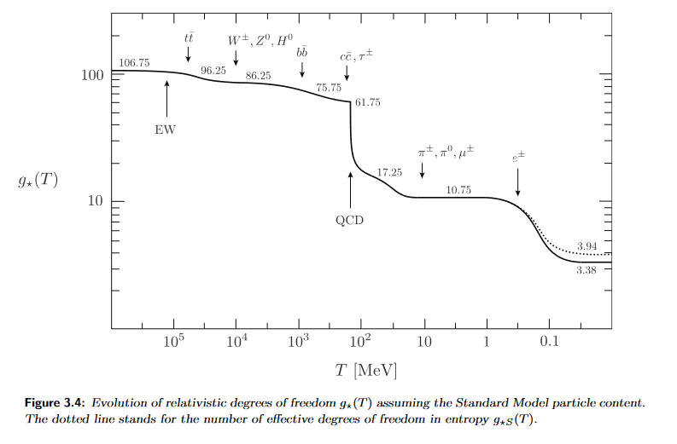
Evolution of relativistic d.o.f.
Next is
but neutrino will
decouple before.
Credit:http://physics.bu.edu/~schmaltz/PY555/baumann_notes.pdf

Slide 33
Entropy conservation in expanding U
Locally Energy changes in expanding U, but entropy is conserved in thermal equilibrium!
Non-equilibrium processes produce Entropy.
S = S(photons) + S(baryons) + S(DM) + S(BH)
S(photons) dominates in radiation era.

Slide 34
Relativistic d.o.f. of Entropy
Using Friedmann eqn, radiation era;
Ex: Show that

Slide 35
Neutrino decoupling
Neutrinos are kept in thermal equilibrium by weak interaction, i.e.,
Competing between scattering and U expansion;
Decoupling when scattering time is longer than expansion time,
For neutrino with weak interaction,
Neutrinos separate from Standard model particles→
neutrino decoupling.

Slide 36
Two thermal equilibria at
Same temperature even after decoupling until
at
For non-neutrinos;
So after annihilation;
Then,

Slide 37
Boltzmann equation

Slide 38
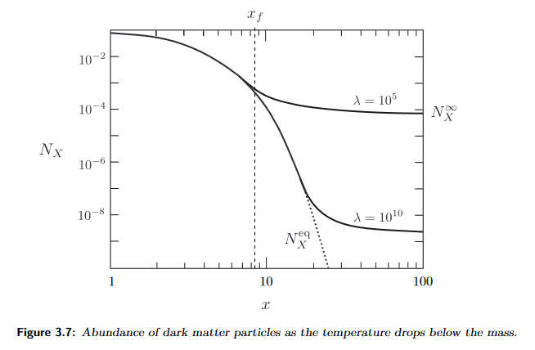
Riccati equation
If DM is WIMP(Weakly Interacting Massive Particle) and assuming
Then
For
Freeze out
Credit:http://physics.bu.edu/~schmaltz/PY555/baumann_notes.pdf

Slide 39
WIMP miracle(???)
From Supernovae fitting and direct counting of visible
matter&estimation we estimate matter density 30% of
critical density with only 5% baryonic matter; So
This could actually relate to WIMP with Weak interaction
frozen out during radiation era!
Weak scattering!

Slide 40
BUT
So far at LHC, elsewhere there is no direct evidence of WIMP with weak scattering…
WTH is DM then???→Please Google or ask Gemini, ChatGPT.
Actually “gravity” might be modified → modified gravity, or Dark Sector of U, or axion, or sterile neutrino, or other exotic particles
WTH is DE????
Next, lets consider Recombination where H-atom was formed(coming before Dark Age, First Stars and Reionization).

Slide 41
Credit:https://cmb.wintherscoming.no/pdfs/baumann.pdf

Slide 42
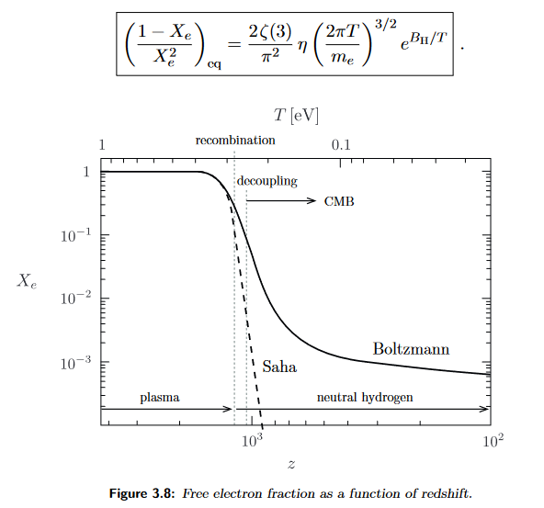
Recombination
H atom is formed and remains when temperature drops below ionization energy of H atom 13.6 eV.
Saha Eqn.
Credit:http://physics.bu.edu/~schmaltz/PY555/baumann_notes.pdf

Slide 43
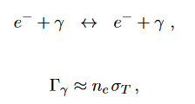
Recombination & Photon decoupling
Some details:
Photon decoupling
Reaction ceases when
Leads to

Slide 44
BB Nucleosynthesis
Successful in reproducing
Or He 25%, H 75% by mass, see details elsewhere(e.g. Baumann notes).
Next, we go back further in order to explain the flatness we see&saw, the validity of cosmological principle in CMB and large-scale homogeneity of matter distribution.
Inflation is a simple good idea as a quantitative explanation.

Slide 45
Inflation
Flatness problem: why density parameter is so close to 1???
(Use to prove)
Who tune this at the beginning?→fine tuning problem in cosmology
Also Horizon problem: how CMB equilibrates to 1/100,000 uniformity throughout the entire sky???

Slide 46
Horizons
Particle horizon = furthest distance we can observe from the PAST.
Event horizon = furthest distance we can observe in the FUTURE.
Conformal time makes things flat and easy to visualize.

Slide 47
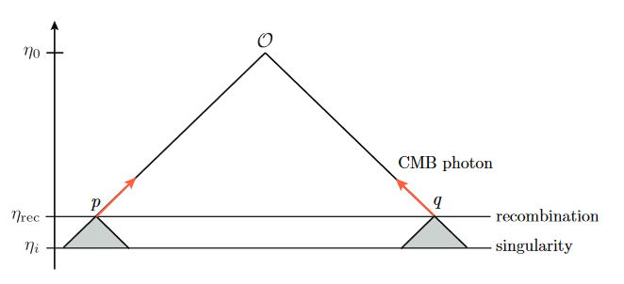
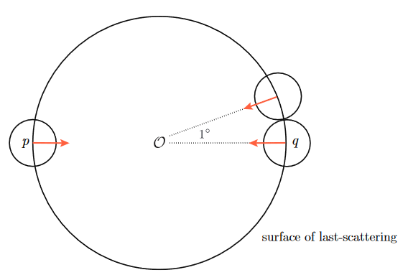
Horizon problem in conformal diagram
Credit:http://physics.bu.edu/~schmaltz/PY555/baumann_notes.pdf
Past light cones at separate regions cannot be in causal
contact, how can they be the same within 1/100,000?
Introduce concept of Hubble sphere or Hubble radius.

Slide 48
Hubble radius determines particle horizon.
Hubble radius can shrink if DE.
Supernice that particle horizon can be any large!!!

Slide 49
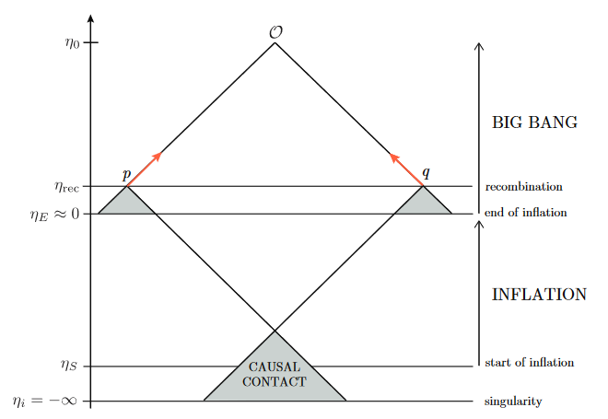
Extending conformal time to -∞ allows anywhere to be in causal
contact in the far past, and the past is infinite to spare with!!!
Credit:https://cmb.wintherscoming.no/pdfs/baumann.pdf
Even before the time of DE in 1998, “DE” was used in Inflation.

Slide 50
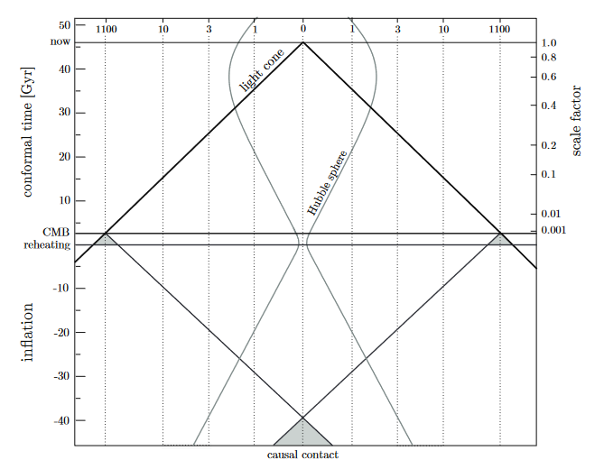
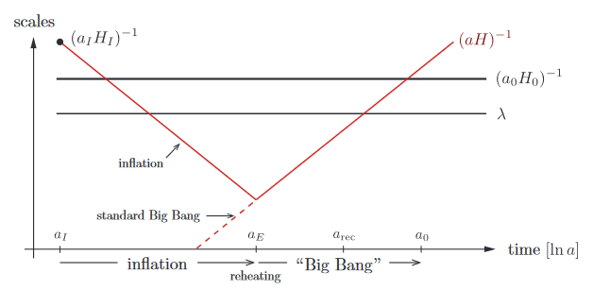
https://cmb.wintherscoming.no/pdfs/baumann.pdf
If we assume GUT as the
symmetric point where inflation Ended and Beginning of HOT Big Bang.
Hubble sphere
should shrink
10^28 during
Inflation until
GUT scale era

Slide 51
Shrinking Hubble sphere ←→ accelerated expansion
But also has to last long enough. Parametrised by
Lets consider inflation toy model using single scalar field called inflaton.

Slide 52
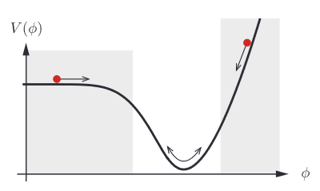
Inflaton toy model
https://cmb.wintherscoming.no/pdfs/baumann.pdf
Friedmann eqn & conservation eqn lead to:
Roll to oscillate at bottom → Reheating

Slide 53
Homogeneity&isotropy of CMB requires at least 60 e-foldings
until GUT scale 10^15 GeV era if we assume GUT as Beginning of
HOT BB.
Depending on model → constraint on inflaton value at start of inflation, usually superPlanckian inflaton due to required e-folding# >60.
After end of inflation, need to transfer inflaton Energy to “Big Bang” particles, i.e., particles we see today.
→ This is “HOT Big Bang”.

Slide 54
Reheating
Energy of inflaton potential needs to transfer to Standard Model particles.
Inflaton decay via coupling with SM matter:

Slide 55
Problems
Baryogenesis, why there is much more particles than antiparticles??? CP violation in SM is too small to account for this.
GUT(Grand Unified Theory) valid? SUSY GUT?
String? Cyclic Universe??? WHAT???
Inflation predicts almost scale-invariant power spectrum which can be tested with Observations.
See Cosmological Perturbations.

