Slide 1
HI-Weak Lensing 2-Point Statistics, Synergies
and Challenges
Anut Sangka in cooperation with ICG, NARIT and MeerKAT

Slide 2
Outline
21 CM line
HI Chronology
LSS from inhomogeneity
Fermat Principle
Gravitational Lensing
Weak Gravitational Lensing
Intensity Mapping (IM) technique
IM challenge
S/N and strategy
KiDs DR4
MeerKAT Pilot surveys
Future

Slide 3
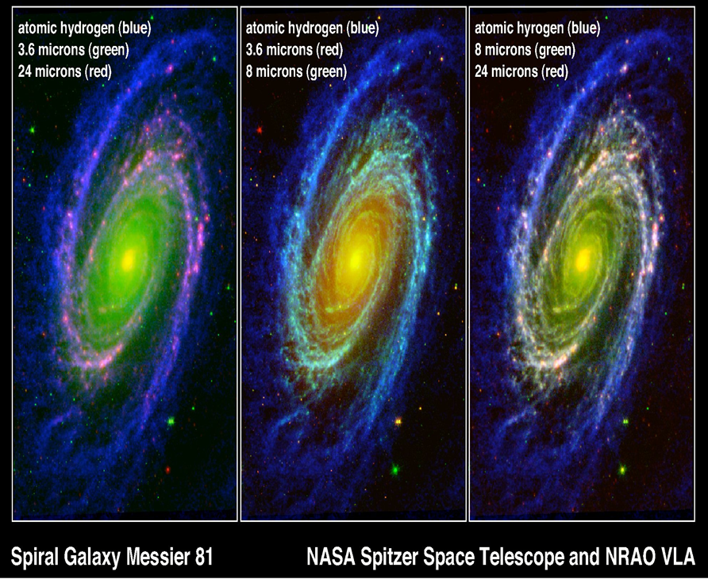
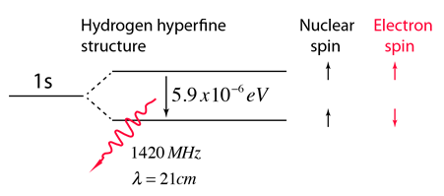
21 CM Cosmology
Hydrogen is the most abundant element in the intergalactic medium!!
Credit: http://hyperphysics.phy-astr.gsu.edu/hbase/quantum/h21.html

Slide 4
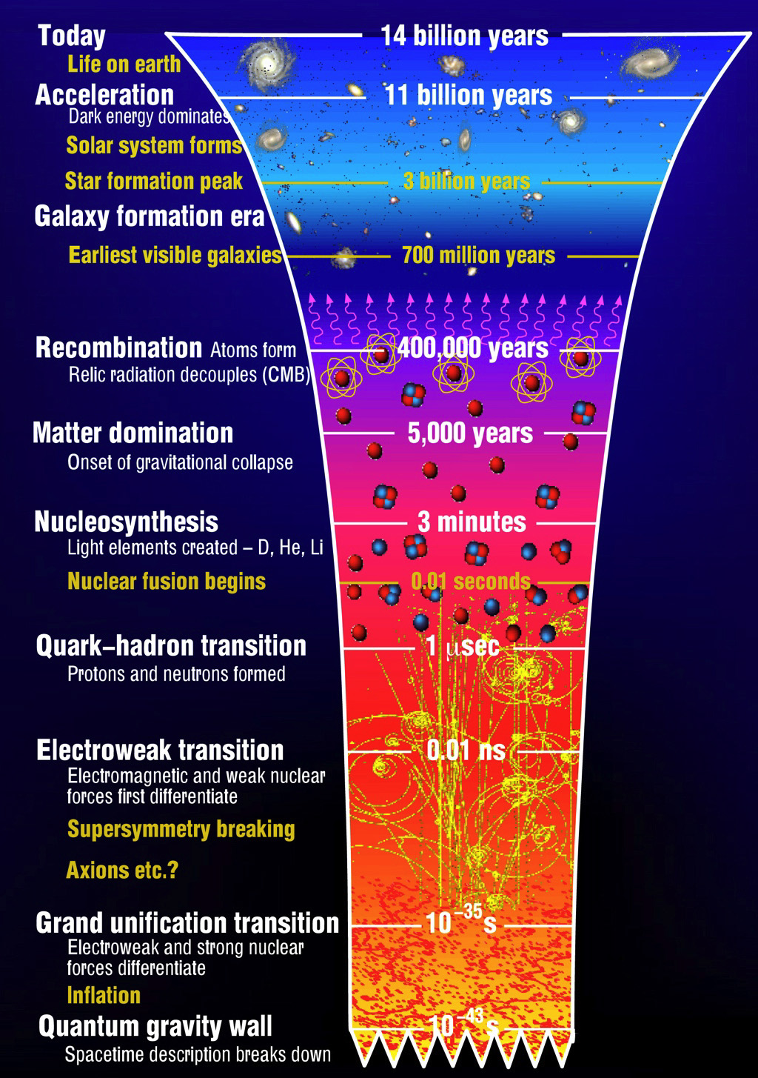
HI Chronology: Early Universe
BigBang/Inflation (t=0): Shortly after inflation, the Protons and Neutrons formed, technically 1st Hydrogen-1 (Prothium) isotope were formed during this time.
Nucleosynthesis (10s < t < 10³s): Light elements created e.g, D, He, Li, but due to high T and high density the universe remained ionised.
Matter-Radiation Equality (t~10¹²s): The densities of matter and radiation were equally. The matter components began to dominate. However, the universe was still too hot to form neutral elements.
Decoupling/Recombination (t~10¹³s): z~1100, T~4000K, photons were decoupling from matter. The earliest comic radiations we can directly observed (CMB). The 1st HI was formed in this era.
Retrieved from: https://www.ctc.cam.ac.uk/outreach/origins/big_bang_three.php

Slide 5
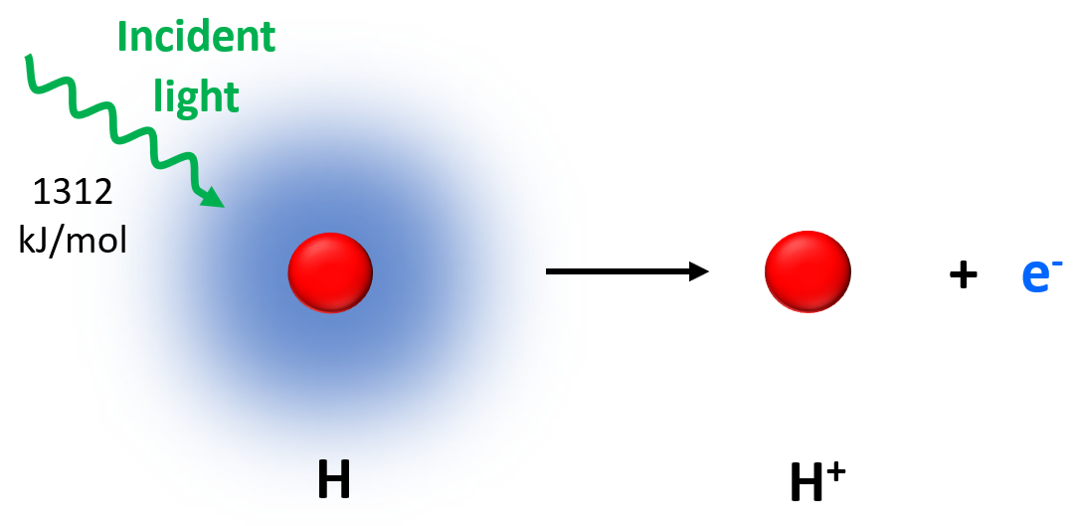
HI Chronology: Dark Ages and Reionisations
The Dark Ages: began after the HI atoms were formed. During this era the amount of HI relatively unchanged. Stars & galaxies has not yet formed. Hence, HI signal from 21cm line is an essential probe to study this era.
Epoch of Reionisation (EoR): When the 1st light from star formation shined the EoR began. The first stars and galaxies were emitting UV that ionised the neutral hydrogen (HII) in the intergalactic medium (IGM). Significant pockets of HI however, persisted in the IGM. The exact time (redshift) of this period is still a subject to be discussed.
Retrieved from: https://www.ctc.cam.ac.uk/outreach/origins/big_bang_three.php

Slide 6
HI Chronology: Post EoR
Only HI in dense regions of galaxies could survived the ionisation process while the universes kept expanding.
Allowing us to consider HI as a bias tracer to Large Scale Structure (LSS).
Due to difficulty in 21cm signal detection, we cannot safely state that the chance to detect HI outside galaxy is zero.
However, late-time HI via computer simulations suggest that majority of post-reionisation HI resides within DM Halo
(Late-time only)
Why ? Have a discussion with your partners

Slide 7
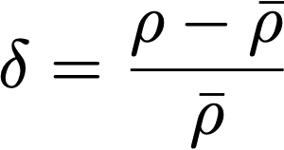
The Inhomogeneous Universe
Cosmological Principle is a linear approximation for large scale.
However, LSS can be formed due to inhomogeneity.
The (Newtonian limit) line element of perturbed RW metric is
where and .
Linear perturbation theory leads to
(Flat, matter dominanted universe)

Slide 8
Inhomogeneous Universe Part 2
We can also approximate density perturbation such that,
Carroll et al (1992)
For flat LCDM:

Slide 9
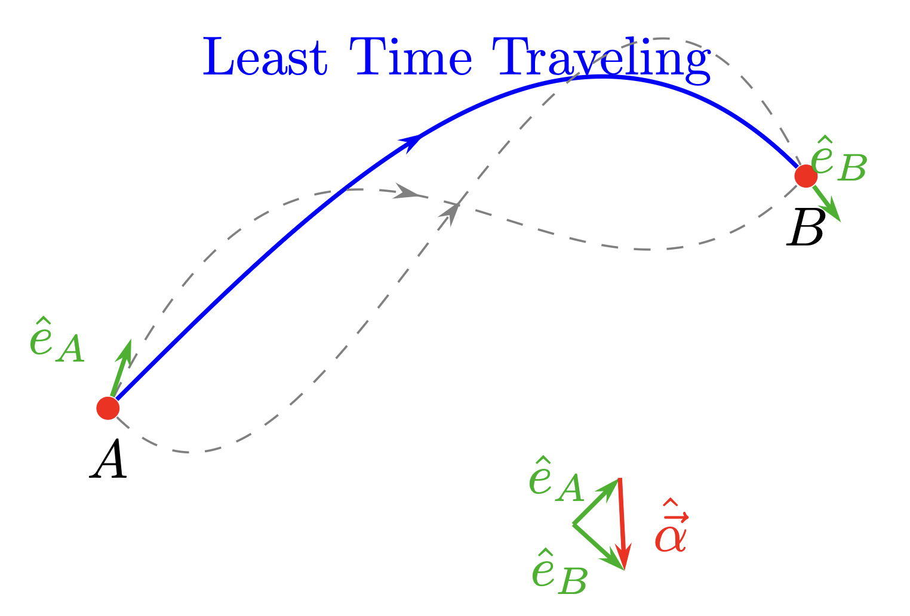
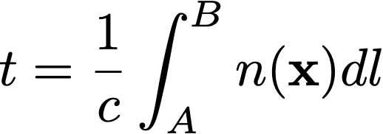
Fermat Principle
The path a ray takes between two points is such that the time taken to traverse the distance is shortest, longest or stationary in relation to nearby rays.

Slide 10
Fermat Principle: Part II
Let
Now we can write down an interval t as:
Varying this integral from $x →x+δx$ and $t→t+δt$, we obtain
where we apply integration by part to the integral get the second integration.
As $δx_{i}$ must be stationary at the end-points A and B, hence the second term must be vanished. The Fermat principle states that $δt=0$, therefore

Slide 11
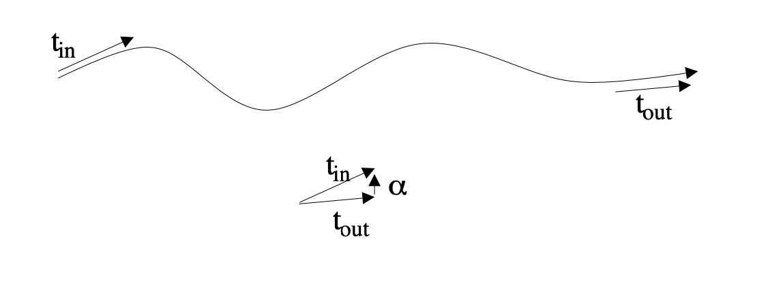
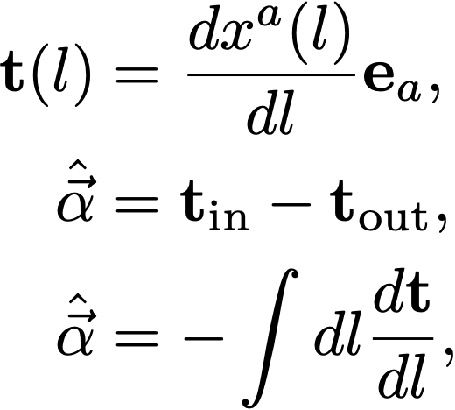
Varying Reflection Index
Deflection vector
Using Euler’s Equation ➡

Slide 12
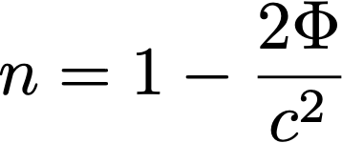
Gravitational Lensing
Gravitationally refractive index
Deflection angle

Slide 13
Modified Gravity
A modification of GR or an anisotropic stress pressure perturbation have a line element such that
This leads to a deflection angle
In the late-time universe the anisotropy in stress-pressure is minimal and can be neglected. So, we can detect the modification of GR via lensing,

Slide 14
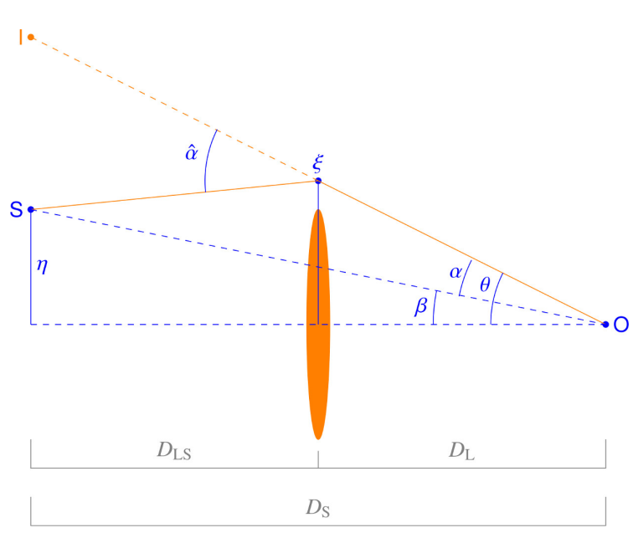
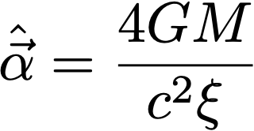
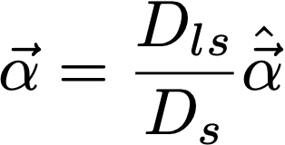
Lens Effect
Born Approximation
Point Mass Lensing
Bertelmann & Maturi 2017

Slide 15
Lensing Potential
Take Divergence
Poisson Equation:

Slide 16
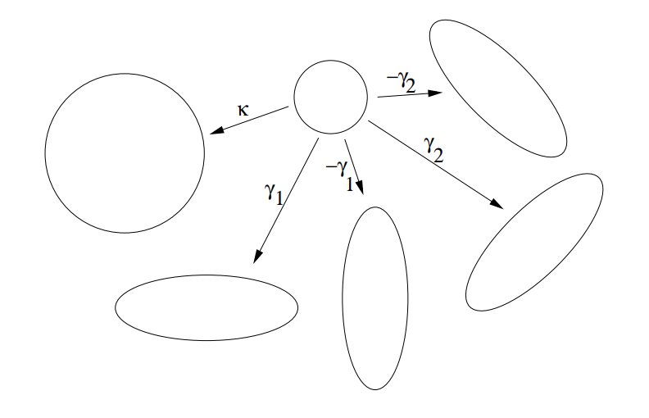
Jacobian and Distortion of Image

Slide 17
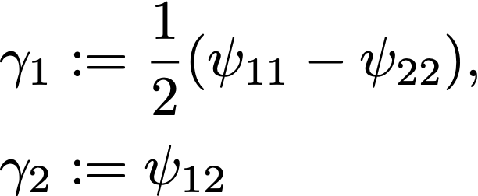
Distortion of Image and Ray Tracing

Slide 18
Weak Regime
Surface Brightness is conserved
can only be detected by measuring distortions statistically
Shear induce ellipticity of circular source
Intrinsic ellipticity variance
Expectation variance ellipticity signal from N galaxies
To detect lensing cosmic variance signal, we require:

Slide 19
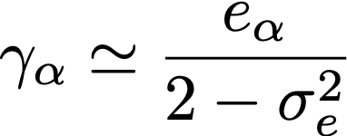
Measuring Shear
quadrupole moments
Blandford & Narayan(1986); Blandford et al. (1991)
Measuring ellipticity is equivalent to mearing shear
Quiz Why ?

Slide 20
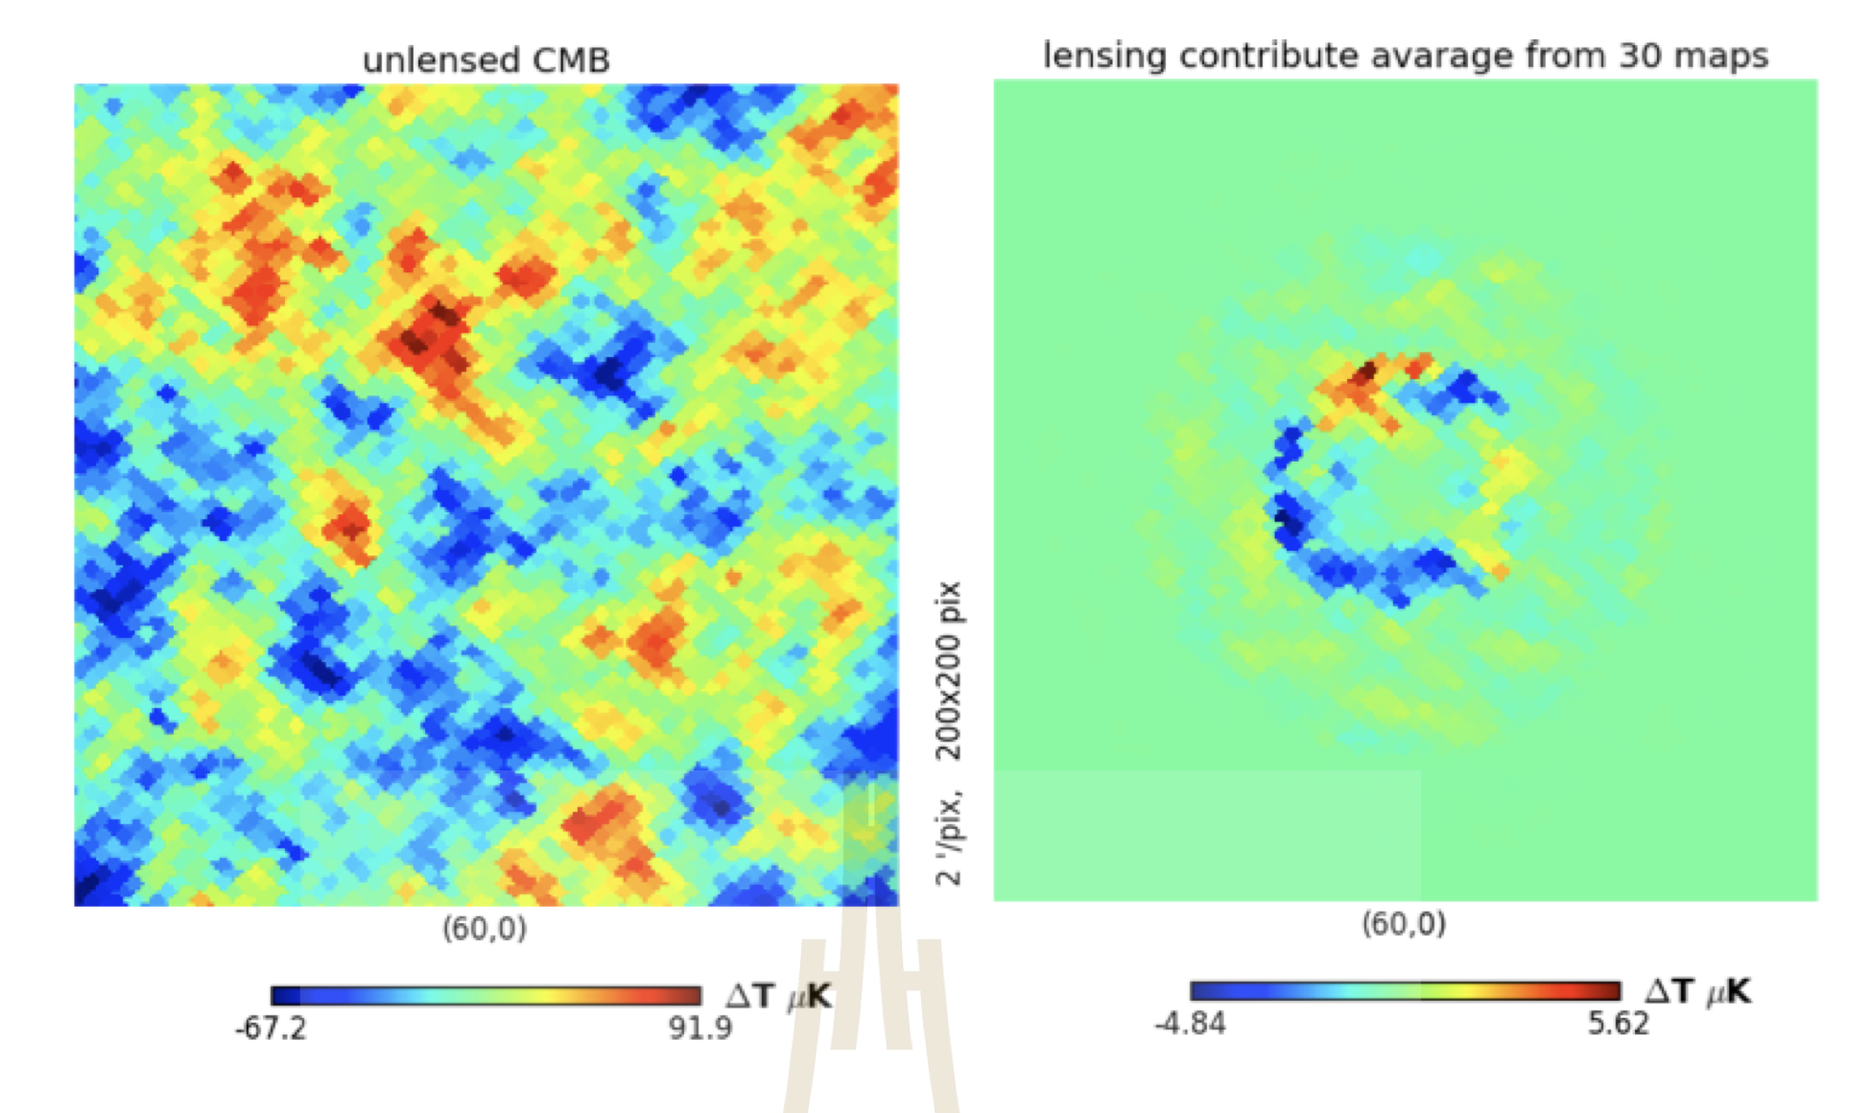
HW
Point Source lensing
Use these equation to create a lensed image
Hint: 2nd order Taylor’s expansion

Slide 21
Write your lens equation

Slide 22
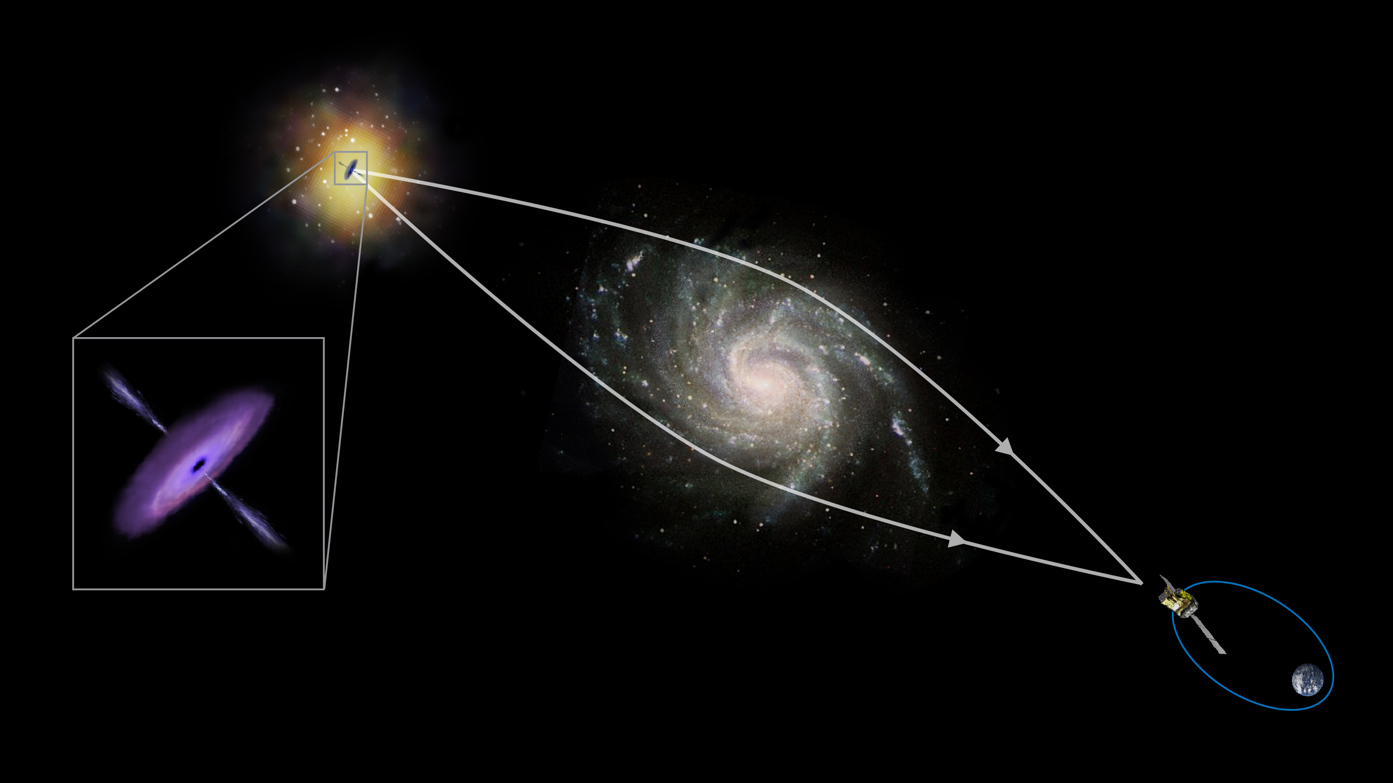
Lensing Kernel
Deflection angle
Lensing kernel
Cr : ESA

Slide 23
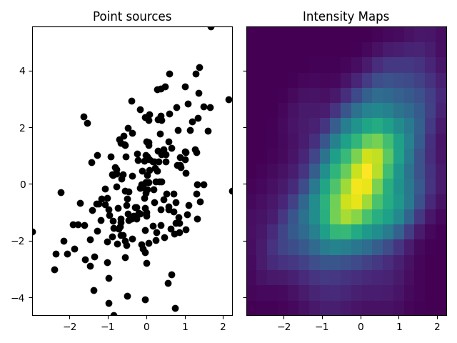
Back to HI: Intensity mapping technique
Lower Resolution but deeper
Battye et al. (2013)
SKA cosmology SWG et. al 2018
Lewis & Challinor, 2007
Notes:
Point source galaxies => integrated pixels of galaxies

Slide 24
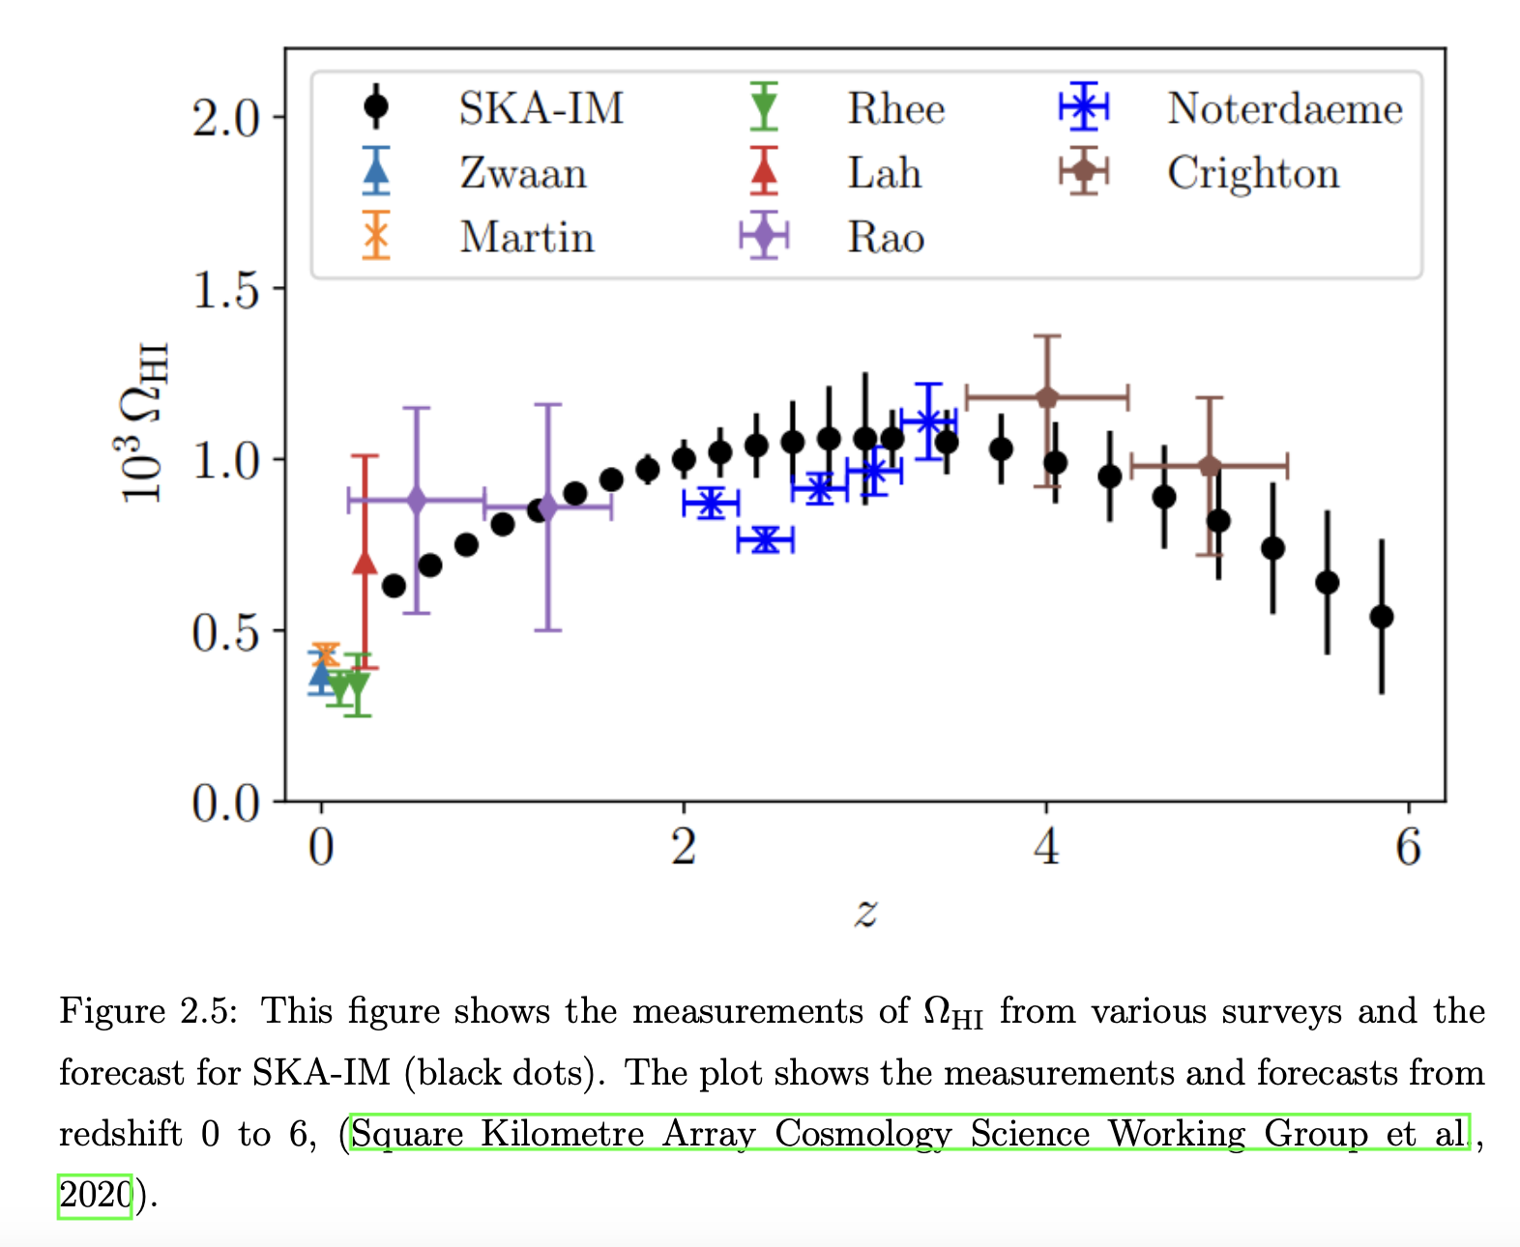

Slide 25
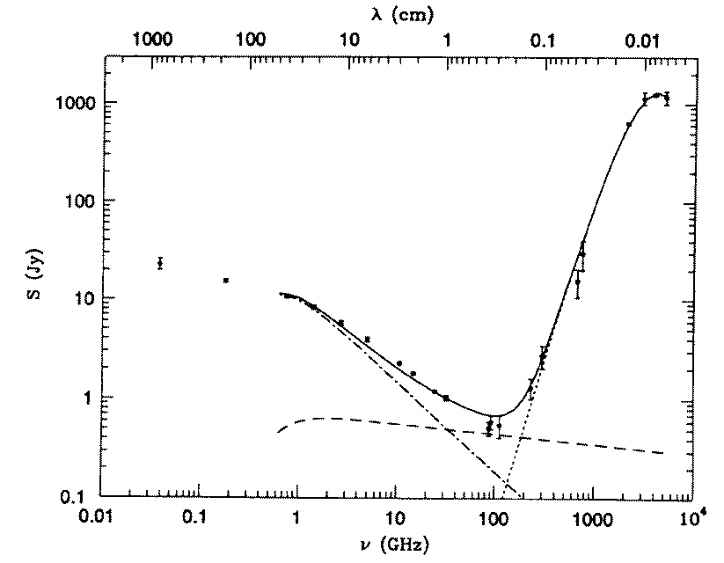
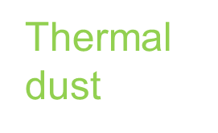
The problem(s)
Low signal compares to foreground, e.g.Galactic Synchrotron Radiation, which has > 3 order of magnitude brighter than HI.
So, we apply foreground removal technique by removing the radial long wavelength modes.
How ever this should reduce the signal in HI-lensing correlation
Poor angular resolutions
HI Bias
Free-Free, point source modelling

Slide 26
2-point functions
Spherical Harmonic
Angular power spectra
small deflection angle => flat sky approximation => Limber approximation
Measuring density perturbation is equivalent to measure gravitational potential

Slide 27
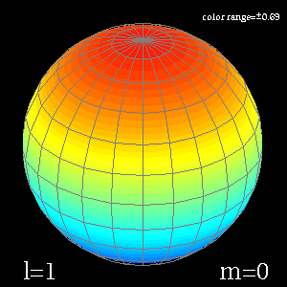
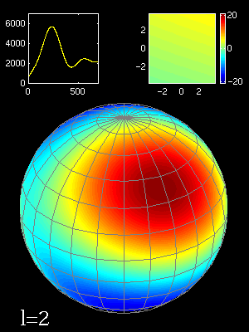
Multipoles Expansion
http://find.spa.umn.edu/~pryke/logbook/20000922/

Slide 28
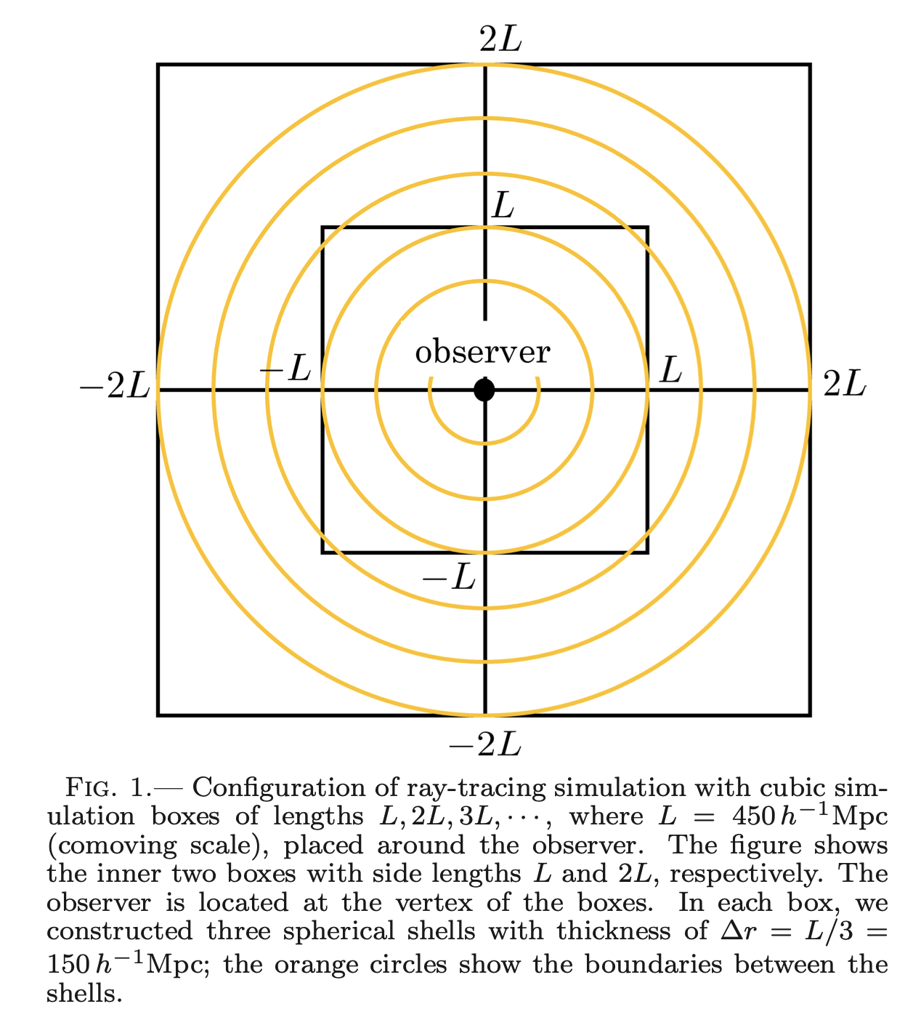
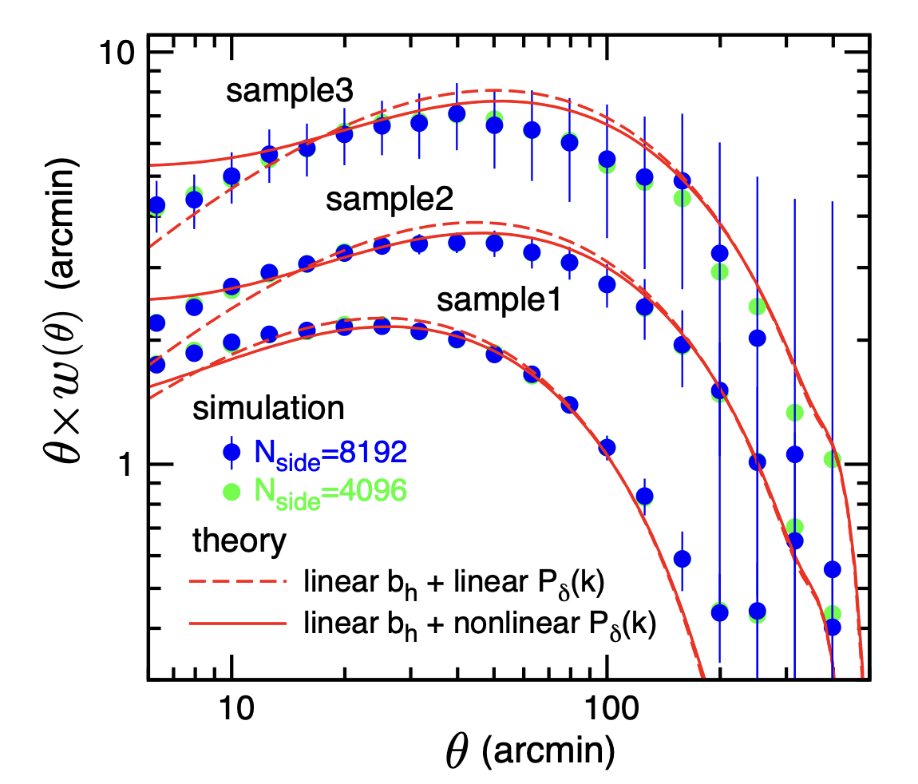
N-Body Simulations
Takahashi et al 2017 1706.01472

Slide 29
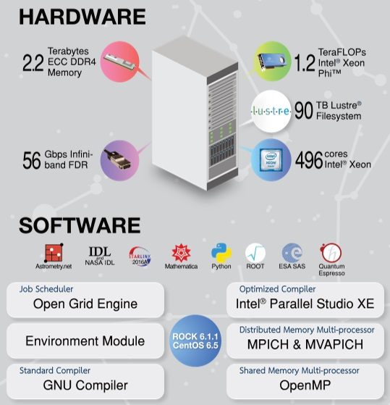
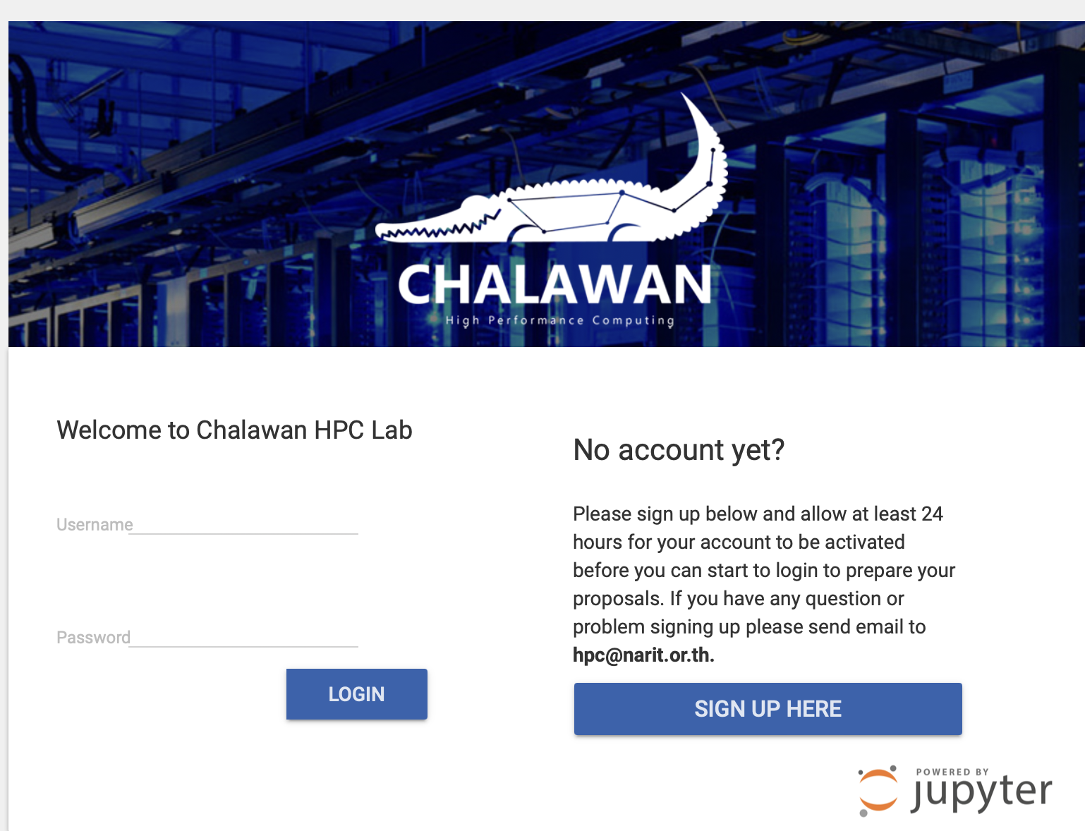
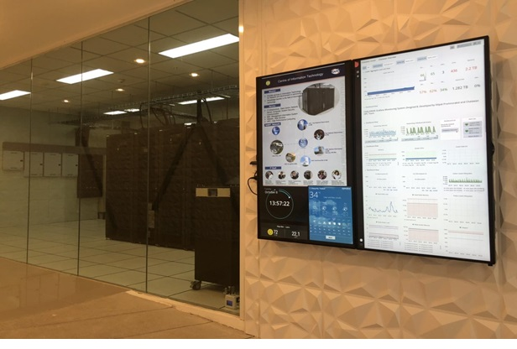
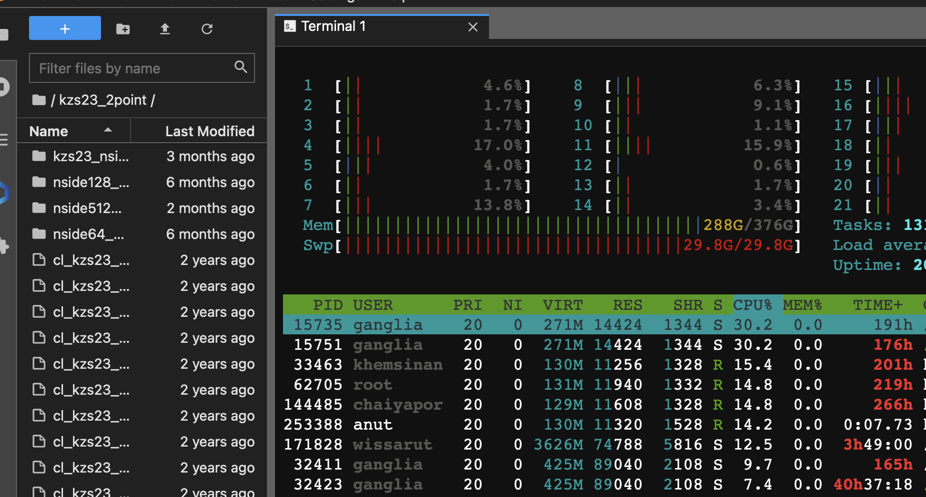
Chalawan HPC

Slide 30
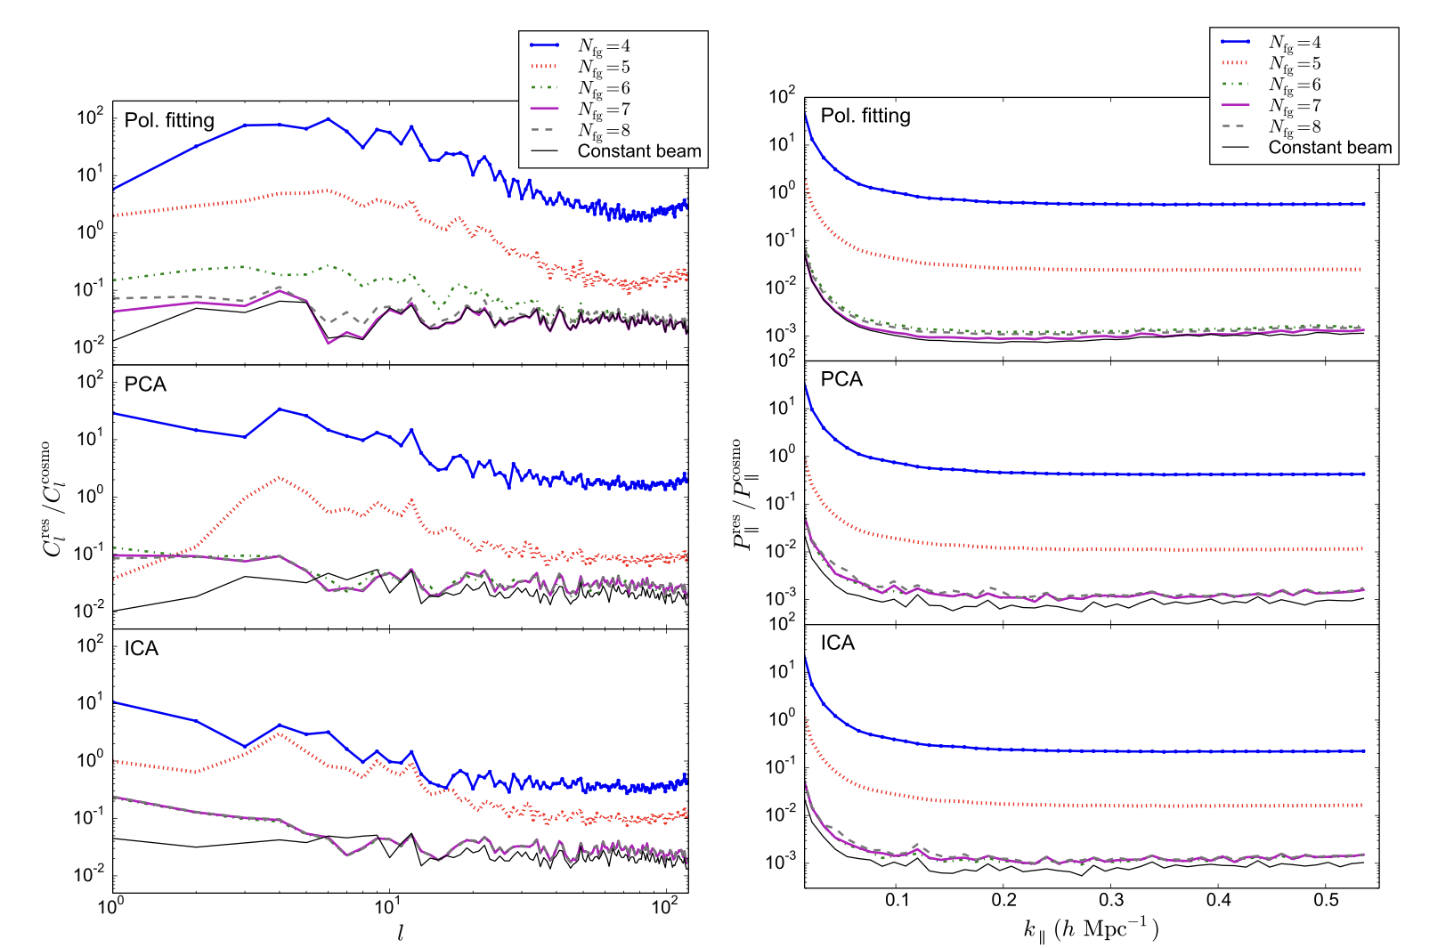
Blind Foreground Subtraction
Alonso et. al 2024 https://arxiv.org/abs/1409.8667

Slide 31
Blind Foreground Subtraction: LoS method
Components
Equivalent to long wavelength mode in radial direction

Slide 32
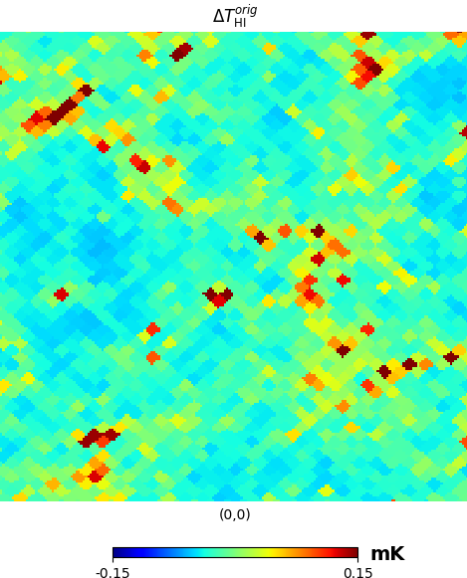
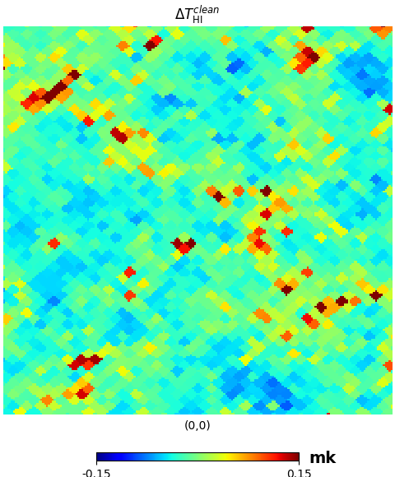
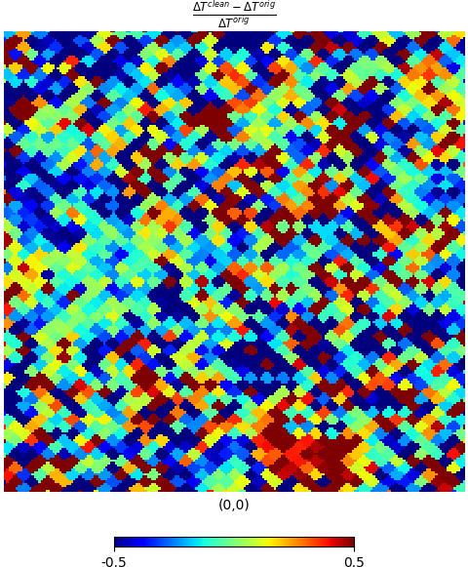
Mock Catalogues & Simulations
Takahashi et al. 2017, based on 9 years WMAP
35 of 107 realisations are selected,
Catalogues provides lensing convergence, using the density profile to generate HI.
Uncleaned
Cleaned
Residue

Slide 33
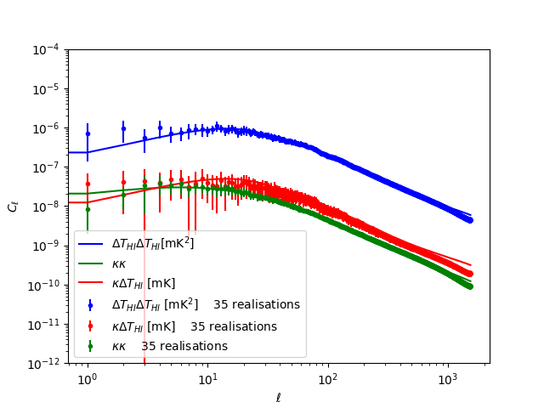
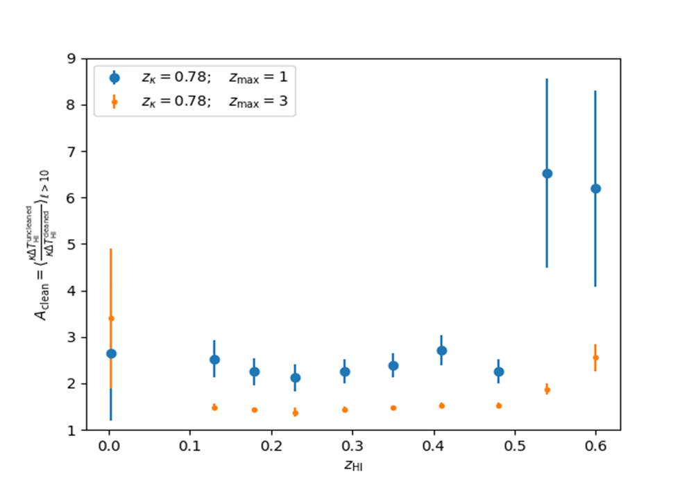
Cross power spectra
They exist
Comparison between, measured and calculated angular power spectra

Slide 34
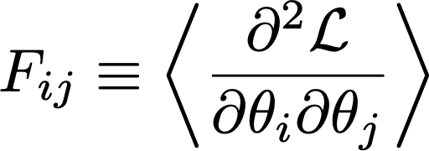
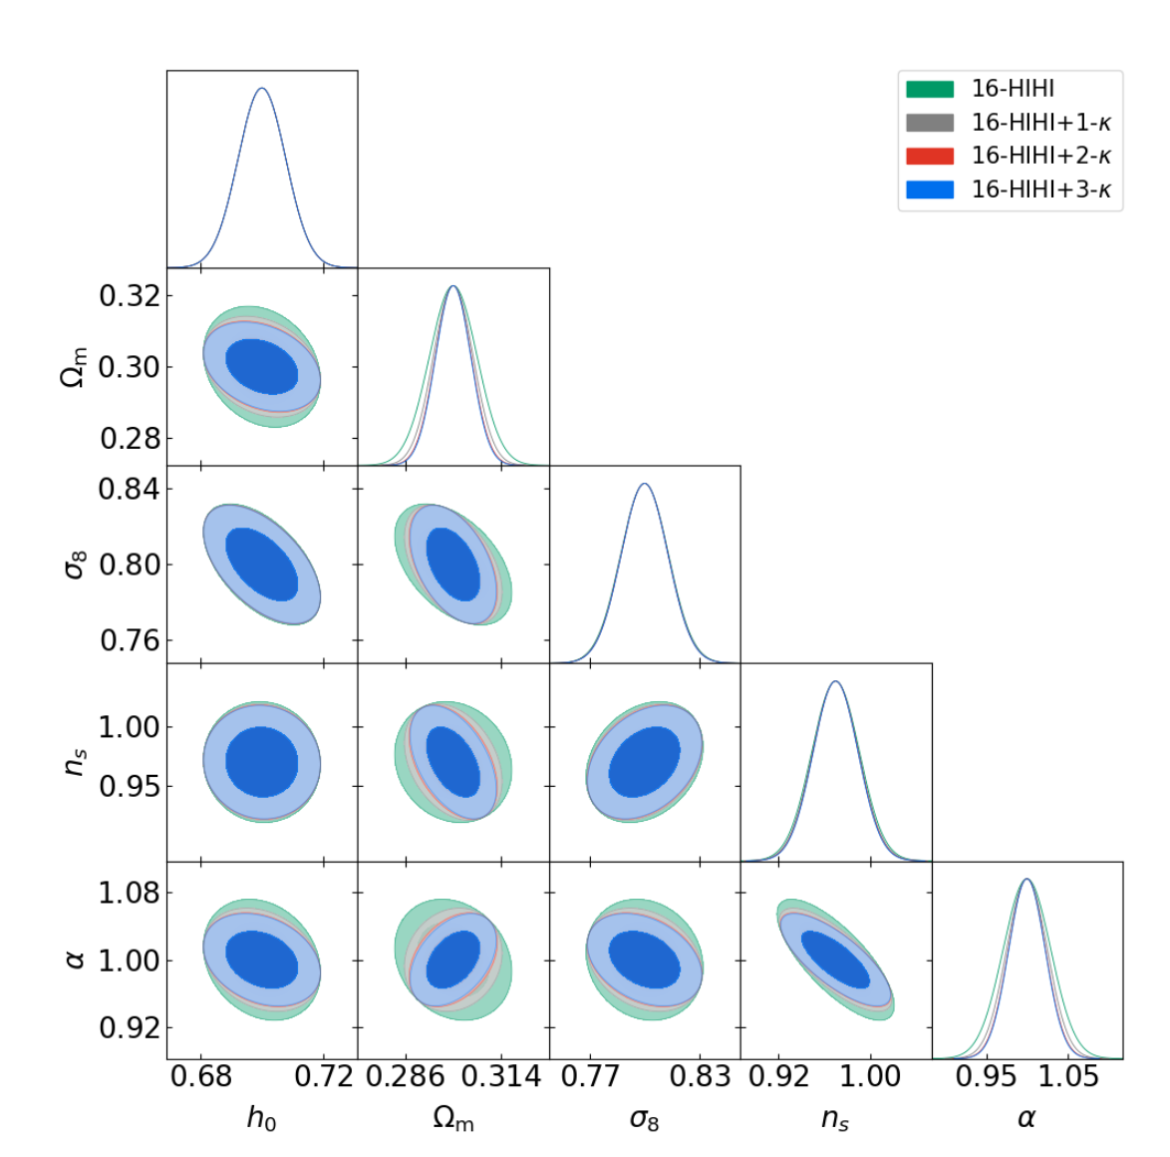
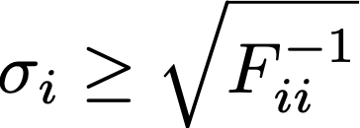
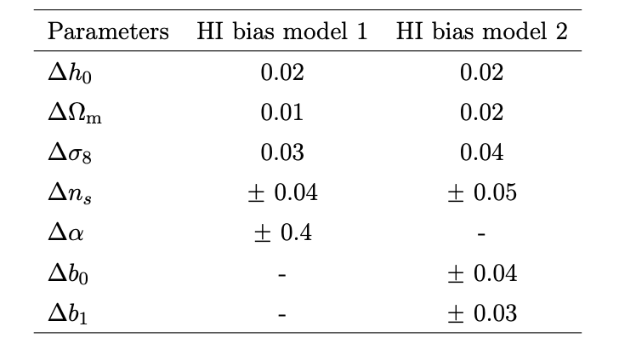
Fisher Forecast

Slide 35
S/N single dish telescope
Santos et al. 2015; Seo et al. 2010
Pointing time

Slide 36
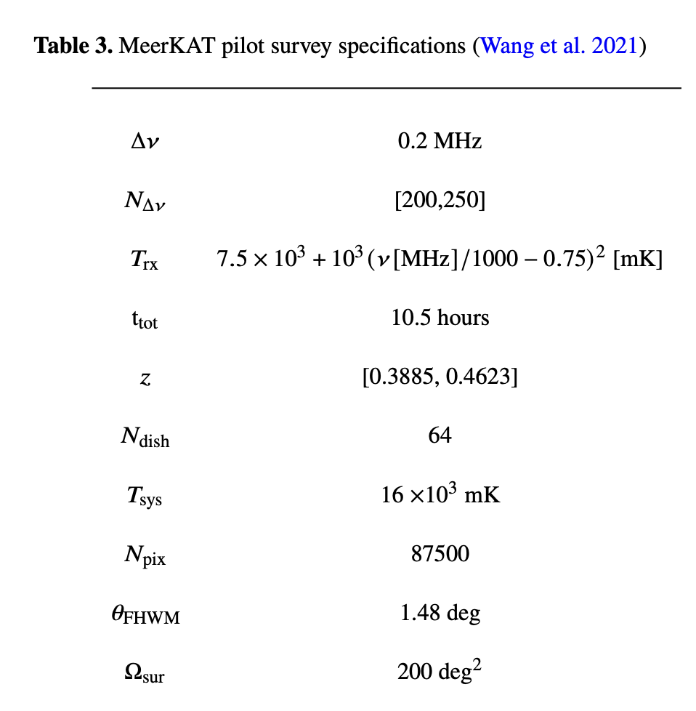
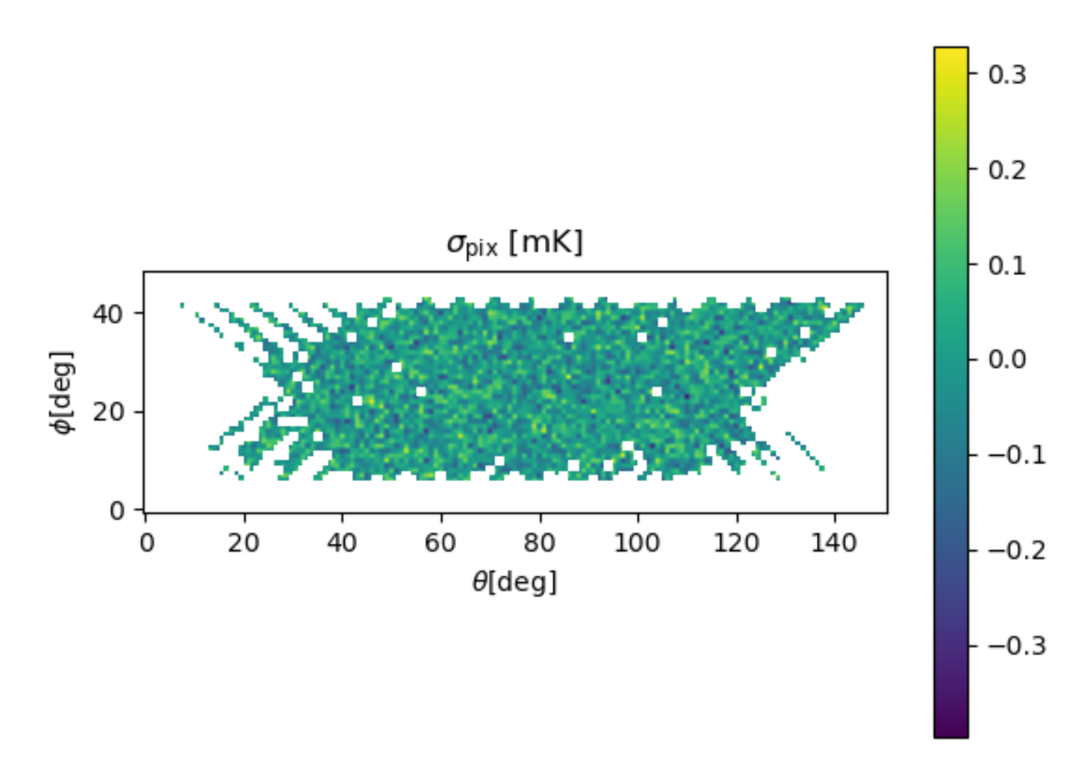
MeerKAT pilot surveys
HW: let calculate TRT’s thermal noise !!!

Slide 37
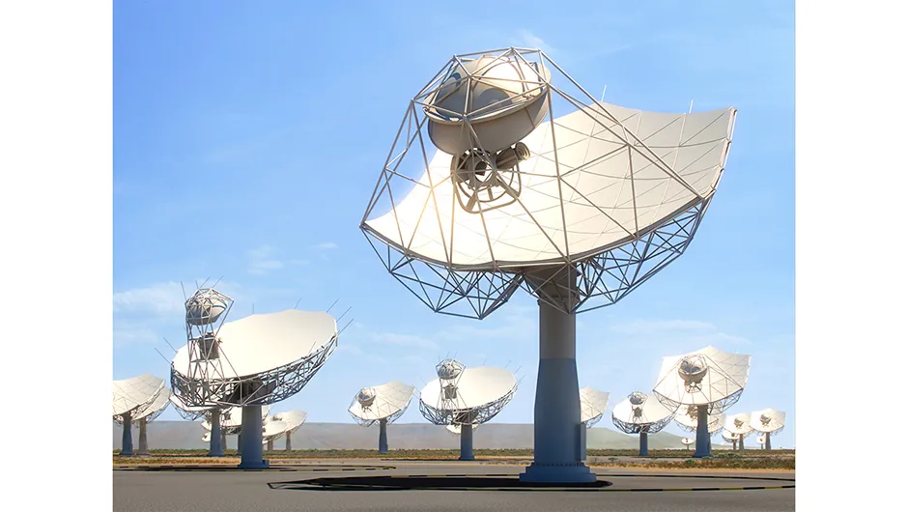
HI intensity mapping Maser Pulsar search Gravitational Physics
Pulsar Timing Array Star formation

Slide 38
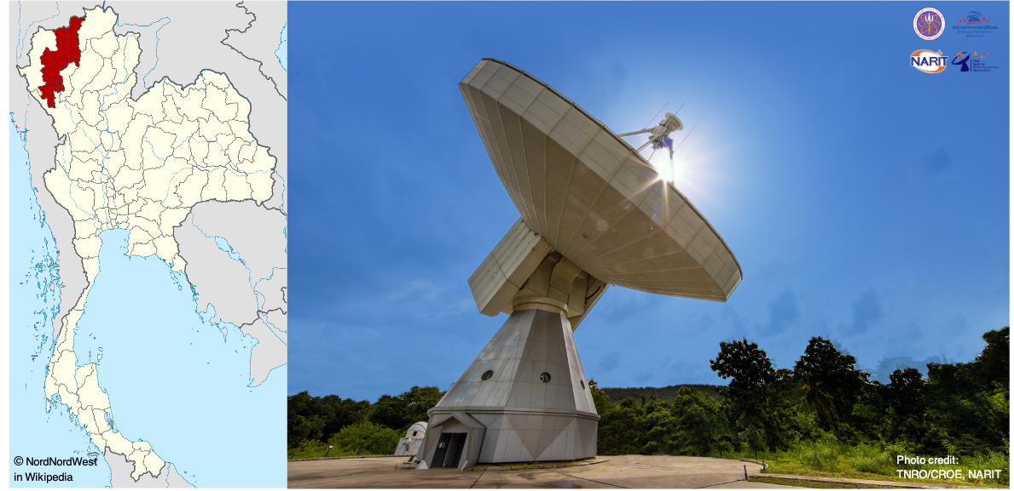
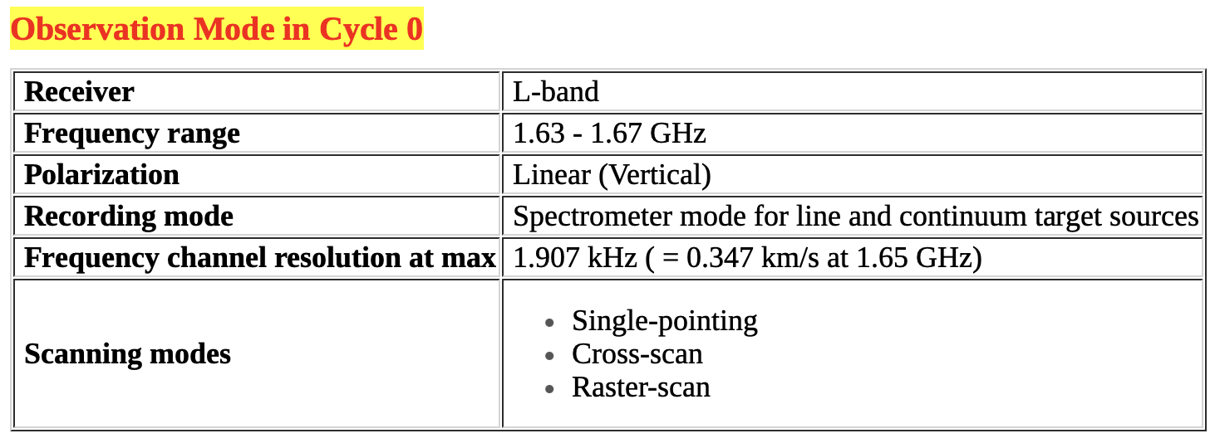
Is it possible to detect HI via TRT ?

Slide 39
$$\frac{S}{N} of κ−HI$$
Question !!!, how can we improve S/N

Slide 40
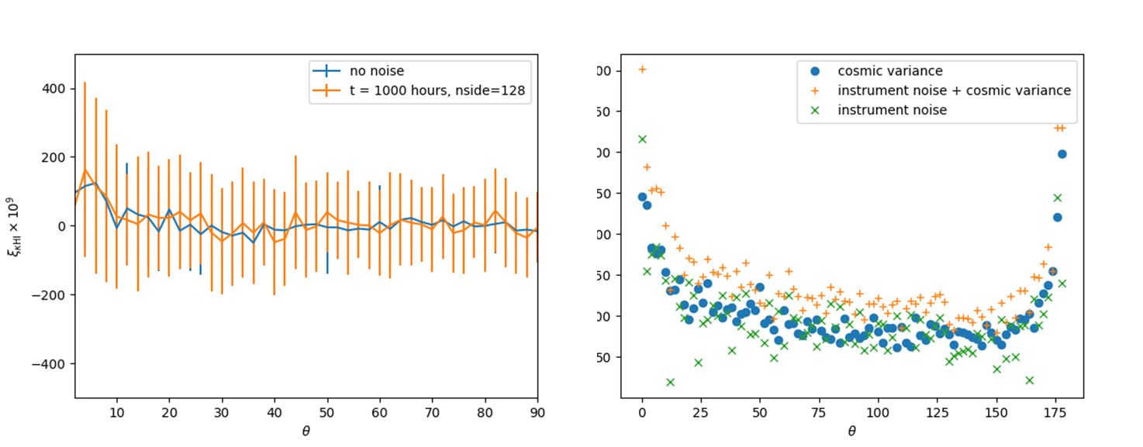
Instrument uncertainty study for forthcoming surveys
We consider the KIDs and DES for lensing and MeerKAT and GBT for HI assuming full-sky surveys + 1000hr exposure time of HI.

Slide 41
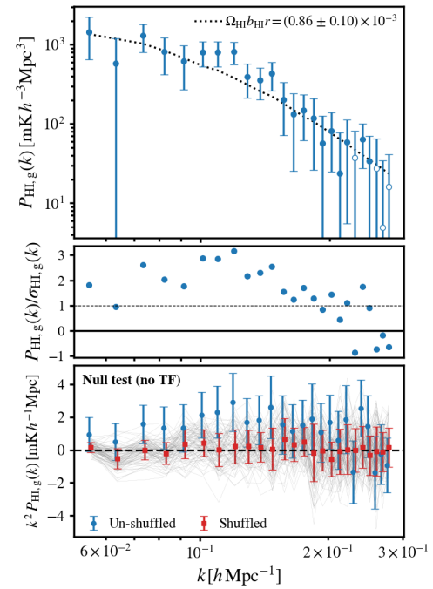
HI-Optical Galaxy correlation
Top:MeerKAT-WiggleZ cross-power spectra by Cunnington et al. (2022); the cross-power spectra is detected at 7.7σ confidence level compared to null-test. This constraint uses the MeerKAT pilot survey (Wang et al., 2021) which has 10 hours observation time with 200 deg2shared sky with WiggleZ. Middle: shows the ratio between data and error. Bottom: shows a null test where the WiggleZ galaxy maps have had been shuffled along redshift. The thin grey lines show 100 different shuffles. The average (red squares) and standard deviation (red error bars) across the shuffled samples are shown relative to the original (blue-dots). In both cases in the bottom panel, no scaling by the transfer function has been applied.

Slide 42
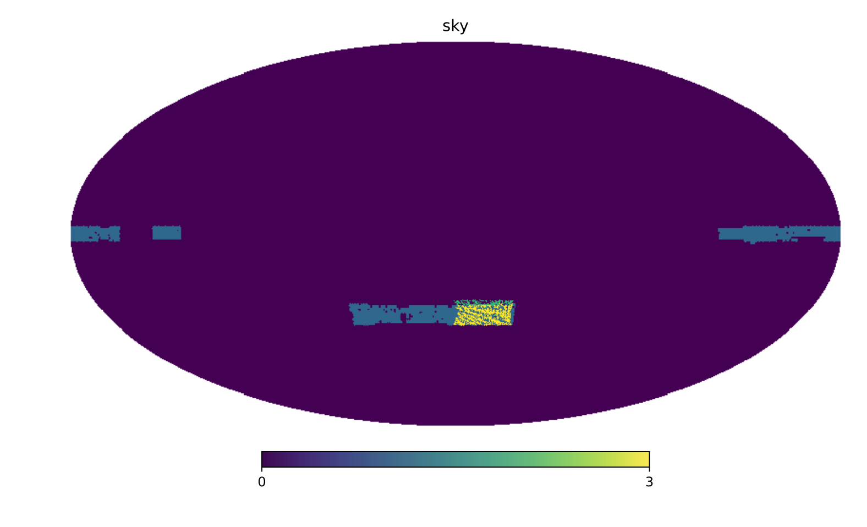
KiDs-1000 & MK pilot survey case

Slide 43
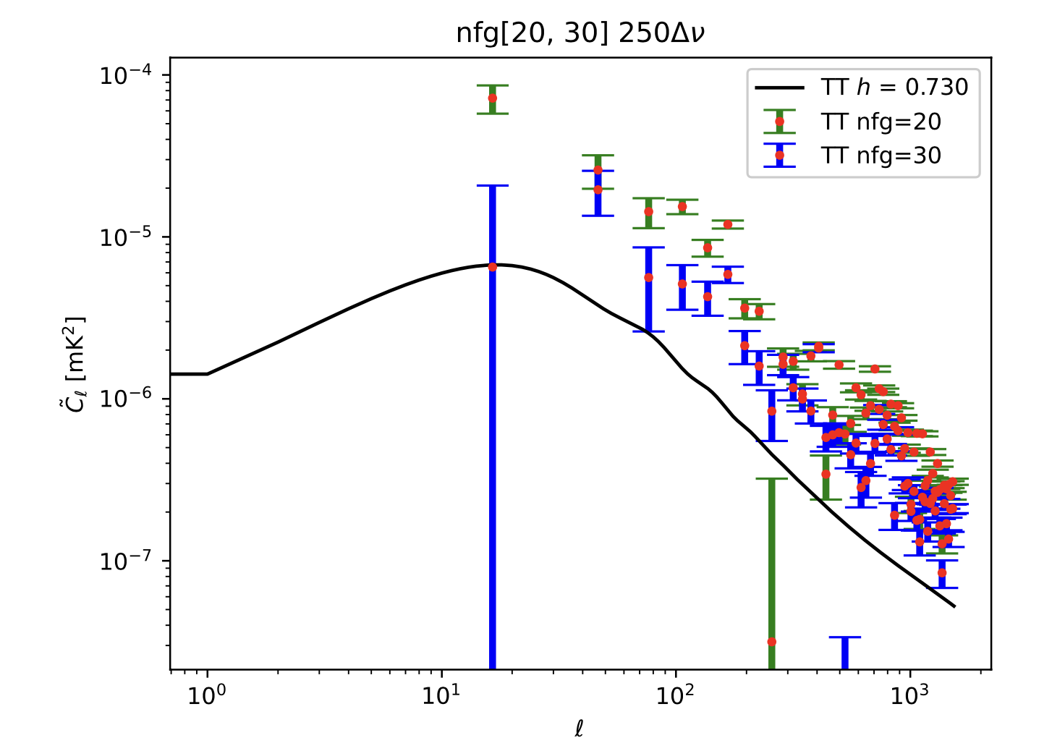
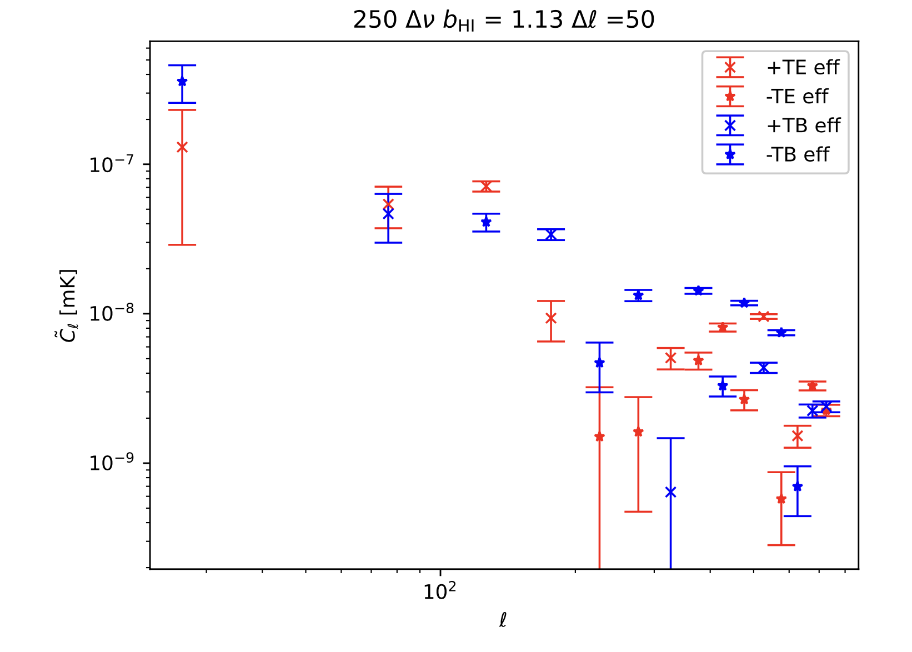
Power Spectra

Slide 44
Conclusion
The signals of cleaned cross power spectra drop by factor
The cross correlations between lensing and HI can reduce the degeneracy of cosmological parameters to sufficient levels. The multiple redshift slices of HI are required for precise cosmological measurement.
The linear evolution model of HI bias is effective enough to constrain cosmological parameters.
Once thermal and instrument uncertainty are considered, the redshift bins size must be efficiently large enough to gain S/N
KiDs-1000 – MK case shows that due to the small area the signal is dominated by systematic errors
However, PCA foreground removal improves the signal especially low (l).
We are about to detect lensing-HI correlations.

Slide 45
Thank You !!!

