Slide 1

Totuorial for weather forecasting and simulation
How do you play with WRF/ESIAS-met
06.06.22 I Yen-Sen Lu

Slide 2
Outline
Brief introduction to WRF&ESIAS-met: Weather Research and Forecasting
How do we use WRF to do weather forecasting?
How do we analysis the data from the simulation outputs?
Outlooks

Slide 3
Brief introduction to WRF&ESIAS-met: Weather Research and Forecasting
Brief introduction to WRF
Features:
  Open Source
  https://github.com/wrf-model/WRF
  Widely Used
  Strong community
  https://forum.mmm.ucar.edu/phpBB3/
National Center for Atmospheric Research (NCAR),
National Oceanic and Atmospheric Administration
  National Centers for Environmental Prediction (NCEP)
Forecast Systems Laboratory (FSL)
Air Force Weather Agency (AFWA)
Naval Research Laboratory (NRL)
University of Oklahoma (OU)
Federal Aviation Administration (FAA)
06 June 22

Slide 4

Brief introduction to WRF&ESIAS-met: Weather Research and Forecasting
Brief introduction to WRF Structure
WRF
WRF
Output
WRF-DA
Input Data
WRF Preprocess
System
IC Data
WRF-HYDRO
BC Data
Namelist
WRF-FIRE
WRF-SOLAR
06 June 22

Slide 5
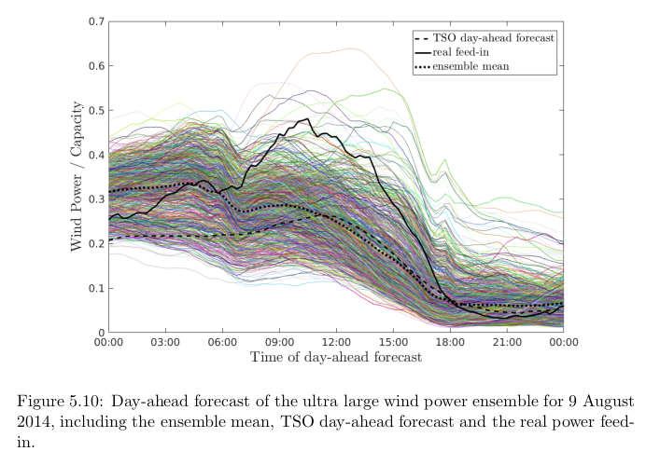
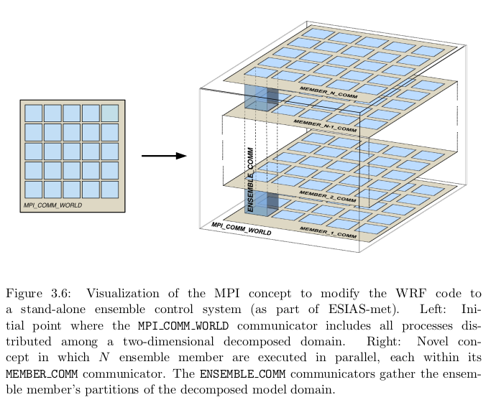
Brief introduction to WRF&ESIAS-met: Weather Research and Forecasting
Brief introduction to ESIAS-met: A Feature toward probabilistic simulation
J. Berndt (2018)
06 June 22

Slide 6

Brief introduction to WRF&ESIAS-met: Weather Research and Forecasting
Brief introduction to WRF/ESIAS-met: how it works
Input Data
WRF Preprocess
System
IC Data
WRF
WRF
Output
BC Data
Namelist
T.B.D
IC Data
IC Data
Input Data
WRF Preprocess
System
IC Data
WRF
WRF
Output
WRF
Output
WRF
Output
BC Data
BC Data
BC Data
Namelist
Namelist
Namelist
06 June 22

Slide 7
How do we use WRF to do weather forecasting?
Simluation workflow
Global Weather
Data
T.B.D
Terrestrial data
WRF Preprocess
System
IC
Data
BC
Data
Namelist
Para-
meters
IC
Data
BC
Data
Namelist
Para-
meters
IC
Data
BC
Data
Namelist
Para-
meters
Ensemble Version
WRF
WPSM
Wind
Power
Ensemble Version
WRF
Ensemble Version
WRF
SPS
Solar
Power
WRF
Output
WRF
Output
WRF
Output
06 June 22

Slide 8
How do we use WRF to do weather forecasting?
I. WRF Preprocess System
Global Weather
Forcing Input
UNGRIB.exe
FORCING INPUTS
METGRID.exe
GFS
GEFS
ECMWF-ERA5
ECMWF-INTERM
FORCING INPUTS
METEOROLOGICAL
INPUTS for WRF
GEO INPUT
GEOGRID.exe
GEO_EM.d01
MODIS-LANDUSE
MODIS-LAI
SOILTYPE
TOPOLOGY
GEO_EM.d02
GEO_EM.d03
06 June 22
Page <number>

Slide 9
How do we use WRF to do weather forecasting?
II. WRF EXECUTORS
METEOROLOGICAL
INPUTS for WRF
REAL.exe
wrfinput_d01
WRF.exe
wrfinput_d02
wrfout_d01
NAMELIST
wrfbdy_d01
wrfrst_d01
Physical
Parameters
additional Outputs
Registry files
06 June 22
Page <number>

Slide 10
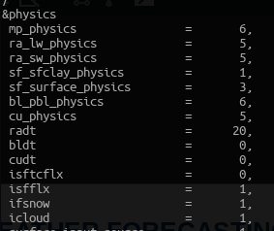
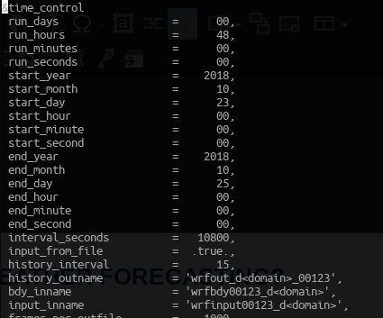
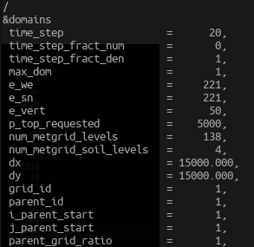
How do we use WRF to do weather forecasting?
III. CONTROLLING YOUR WRF
NAMELIST
Physical
Parameters
06 June 22
Page <number>

Slide 11
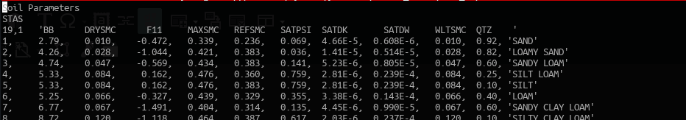
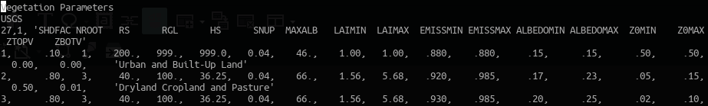
How do we use WRF to do weather forecasting?
III. CONTROLLING YOUR WRF
NAMELIST
Physical
Parameters
06 June 22
Page <number>

Slide 12
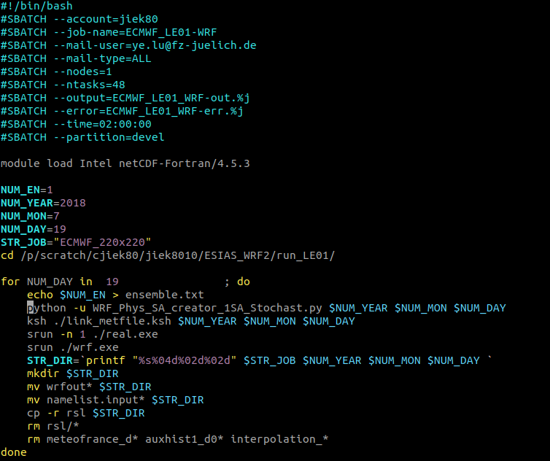
How do we use WRF to do weather forecasting?
Using HPC with Slurm:
06 June 22
Page <number>

Slide 13
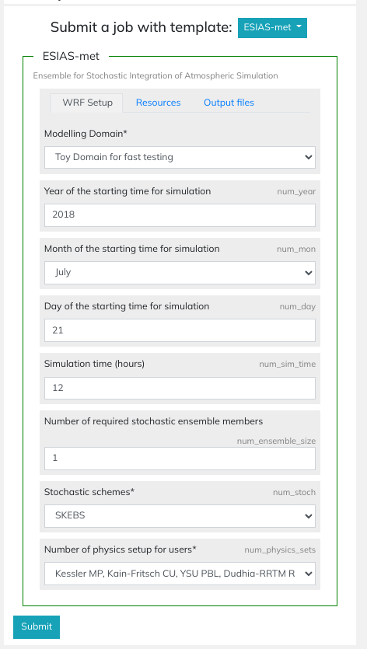
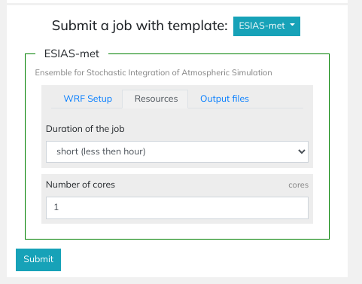
How do we use WRF to do weather forecasting?
Using SaaS Portal
06 June 22
Page <number>

Slide 14
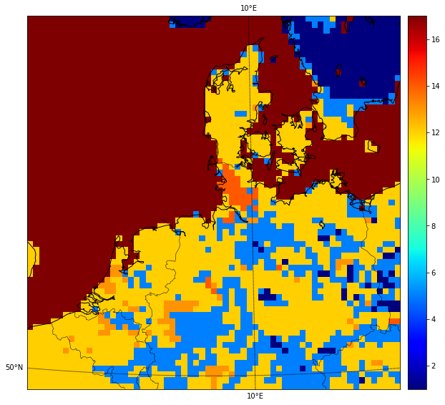
How do we analysis the data from the simulation outputs?
Model Output
dy
dx
dz
dt
dt
06 June 22

Slide 15
How do we analysis the data from the simulation outputs?
Data position
Vj+1
M
Ui+1
U
V
06 June 22

Slide 16
How do we analysis the data from the simulation outputs?
Tools
NetCDF4 supports:
  NCL
  Python-netCDF4
Friends of Data Science (e.g. python)
  xarray
  numpy
  scipy
  Pandas
WRF-PYTHON
  Generate right diagnostic variables
mpi4py
  Large data
  Batch processing
Basemap
Cartopy
06 June 22

Slide 17
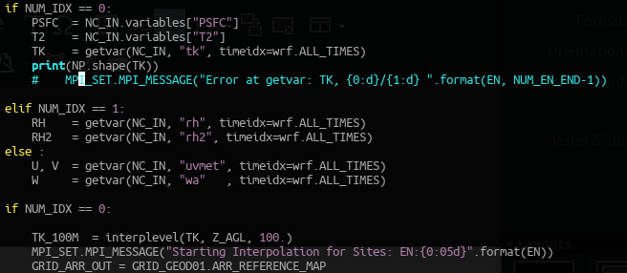
How do we analysis the data from the simulation outputs?
Important Tool & Examples
With wrf-python:
y
v
x
u
06 June 22

Slide 18
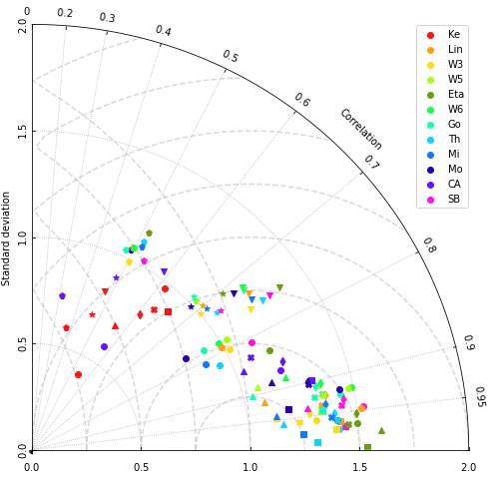
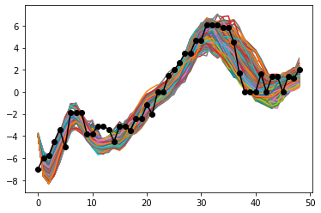
How do we analysis the data from the simulation outputs?
Examples: Lineplots and Taylor’s Plot
06 June 22

Slide 19
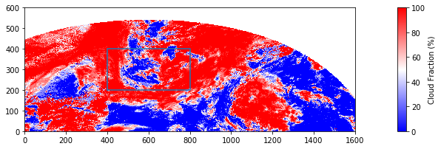
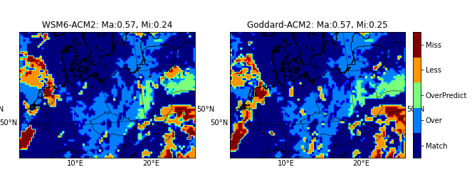
How do we analysis the data from the simulation outputs?
Examples: Instant snapshot
06 June 22

Slide 20

How do we analysis the data from the simulation outputs?
Important Tool & Examples
With xarray:
06 June 22

Slide 21
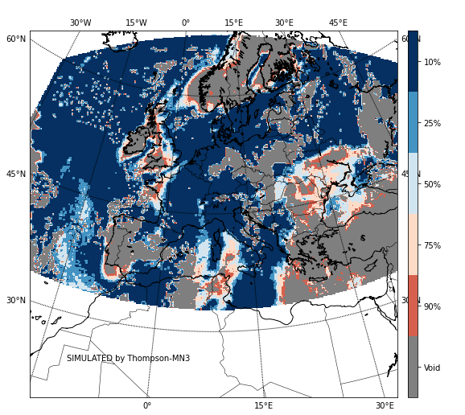
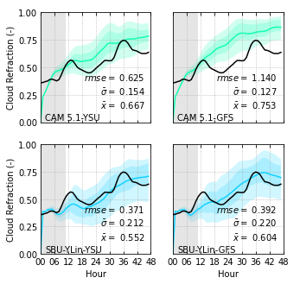
How do we analysis the data from the simulation outputs?
Examples: Probabilistic Analysis
06 June 22

Slide 22
Outlooks
Pro & Cons about WRF ...
Open Source
Strong Support
Easy to use
  Clear instruction
  Clear namelist and variable description
Complicated system
Hard to tune
  Required knowledge in Atmospheric physics & CFD & Numerical Modelling …
Some input is needed
  Global weather forcing ( for real cases)
06 June 22

Slide 23
Outlooks
What you can do:
Installing from scratch
Playing with GEFS data
  https://www.ncei.noaa.gov/products/weather-climate-models/global-forecast
Practicing with PYTHON
06 June 22

Slide 24
ASSIGNMENT
Hamburg and Bremen are in competition for building wind farm near the city. Which location is better for doing it?
Germany is keen to build for more solar panel plants. Which location(s) is suitable for doing it?
* Limitations:
4 ensemble members on EAGLE.
* Hints
Try to plot with single locations with interpolation.
You may use one day data for doing it.
Try to avoid analysing with “spin-up” time
Try to plot with probability.
The evaluation is based on your logic in analysis.
Join the additional HPC (was number 7 in TOP500!)
https://judoor.fz-juelich.de/projects/join/training2220
Data here: /p/scratch/share/ESIAS-met/ESIAS-met-output
Jupyter there: https://jupyter-jsc.fz-juelich.de/hub
06 June 22

Slide 25
Thank you
For
Your Attention

